Slide 1




Thank you for joining us today!
To ensure the effectiveness of this web meeting:
  Only the host and presenters will be unmuted.
  All other participants will be muted during the presentation.
  View settings can be adjusted by clicking on the navigation bar above the video or by dragging and placing the video on the lower right corner of the screen.
We encourage and welcome your questions!
  Please use the ZOOM Chat function to submit questions.
  At set breaks, questions will be addressed by the presenters.
Open the Chat function
Type questions in the Chat section

Slide 2
Utilizing Process Improvement to Drive Strategic Organizational Alignment and Development Potential of Staff
Presented by: Kelly Feister

Slide 3
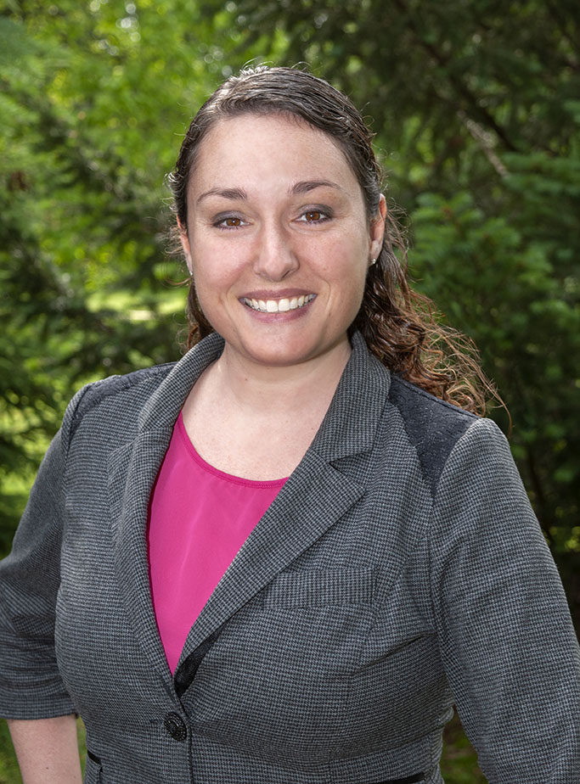
Kelly Feister
Kelly Feister is a Business Office Manager for Michigan State University. She works in the Building Services department for the Division of Infrastructure Planning and Facilities.
Using her background in process management, she specializes in process discovery and development, work control, and emergency procedure management. In her time at Michigan State University, Kelly has helped to develop, implement, and streamline several division wide processes. A majority of her time is spent managing the departmental business office which includes all human resource and work control related duties.
Kelly enjoys discovering efficiencies in processes and helping to develop her team members.

Slide 4
What will we talk about?
Organizational context and change
Understanding the difficulties in making organizational process changes​
The path we took to develop and deliver a business plan for organizational alignment​
Recognizing the benefits in maximizing the development potential of employees​
The value of regular check-in meetings

Slide 5
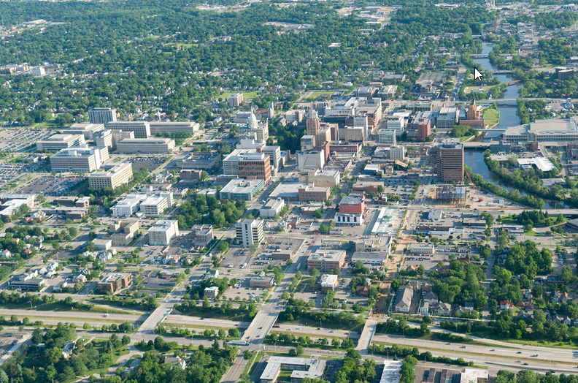
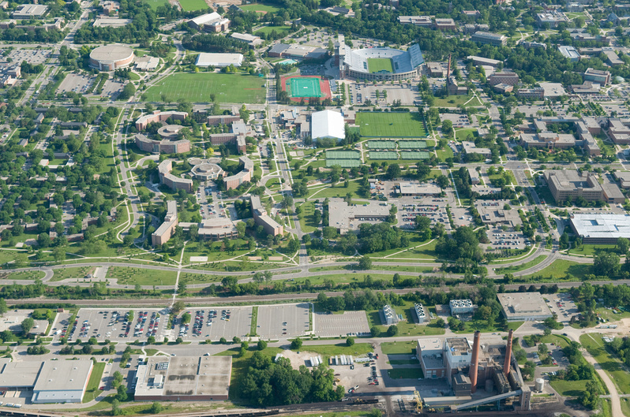
Organizational context
Michigan State University
  50,000 students
  13,000 faculty/staff
  5,200 acre main campus
Infrastructure Planning and Facilities (IPF)
  1300+ employees
  7 major business units

Slide 6
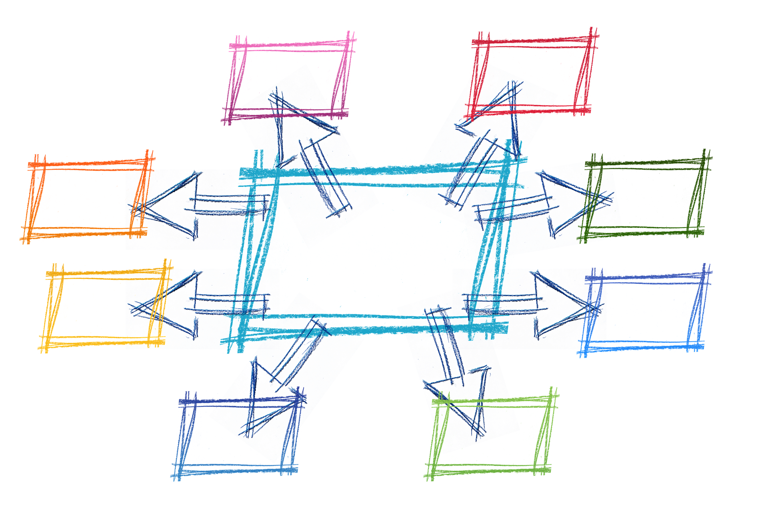
IPF – organizational change
2014 was just the beginning
  New Associate Vice President after 50 years
  Leadership restructure
    Moved from silos to a matrix organization
    Advisory and Strategy committees formed
  Installment of Business Leaders
    Group of functional managers from across the organization
    Started meeting (and talking) about:
      What was happening in their department
      How it might affect others

Slide 7
What about you?
Please use the chat function to answer the following:
  Have you been through an organizational change?
  Was it your unit or department (or both)?
  How did it go?
    Smooth
    Rocky
    Still going through it

Slide 8
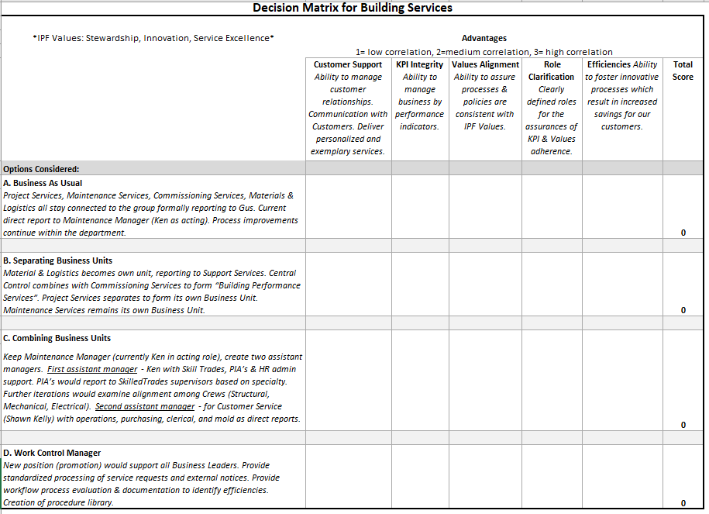
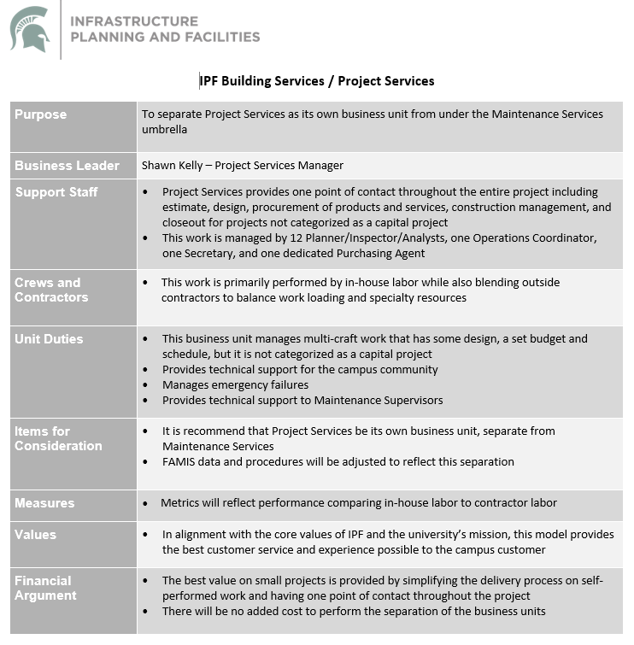
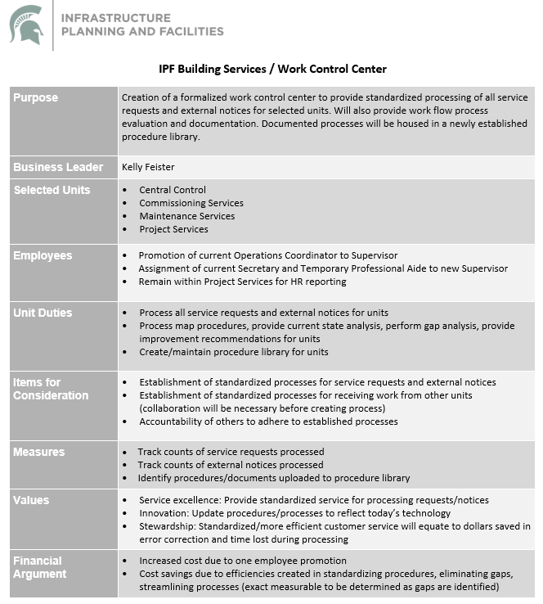
Building Services organizational change
Use of consultant that helped with the IPF wide org. change
Developed four distinct plans
Utilized a decision Matrix

Slide 9
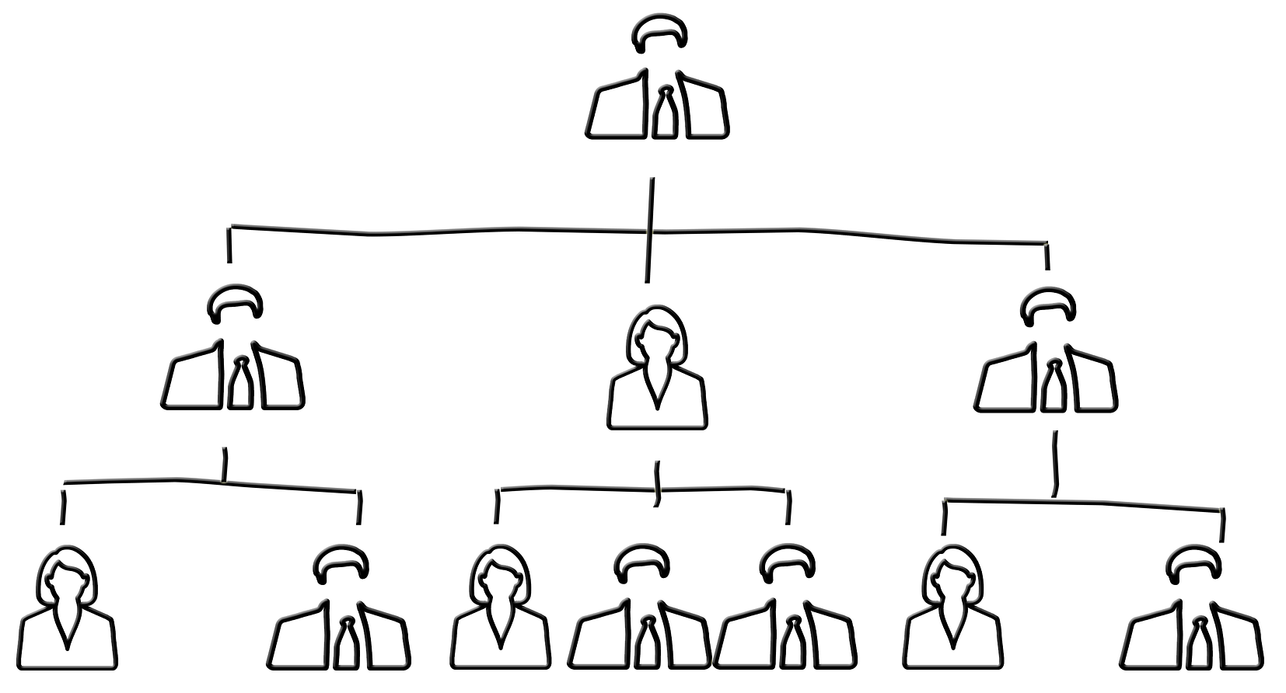
Building Services org. change continued
2016 – more change
  Maintenance Services – addition of 3 Assistant Managers
    Administrative assistants still report to Maintenance Manager
  Project Services is no longer under Maintenance Services
    Work Control group formed and reports to Project Services Manager
  Building Performance Services – combined Commissioning and Central Control
  Material & Logistics – moved to Support Services
  Custodial Services – moved to Campus Services

Slide 10
Building Services org. change continued
End of 2016
2017
Interim Director announces retirement
National hiring search is conducted
Continued / additional organizational moves identified but put on hold
New Director is hired
Maintenance Manager “retires”
Assistant Managers become Managers reporting to Director
Administrative Supervisor takes position in new department
I began as acting Supervisor of Administrative team
  Interim assignment until plans were finalized

Slide 11
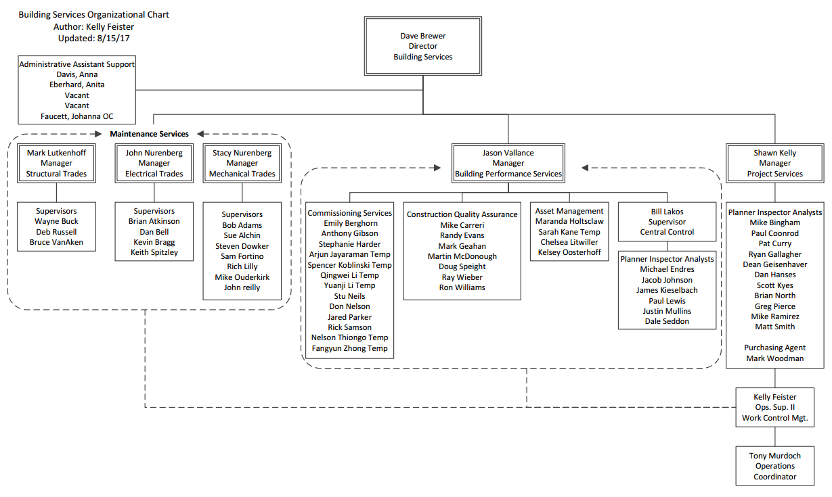
Initial organizational chart

Slide 12
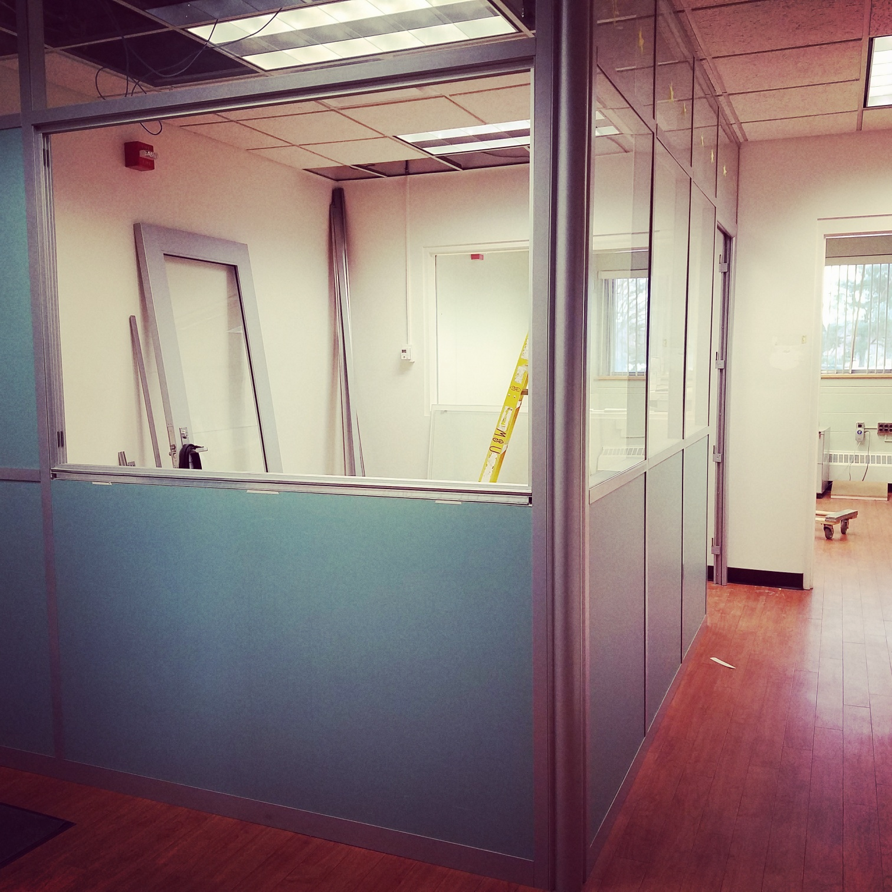
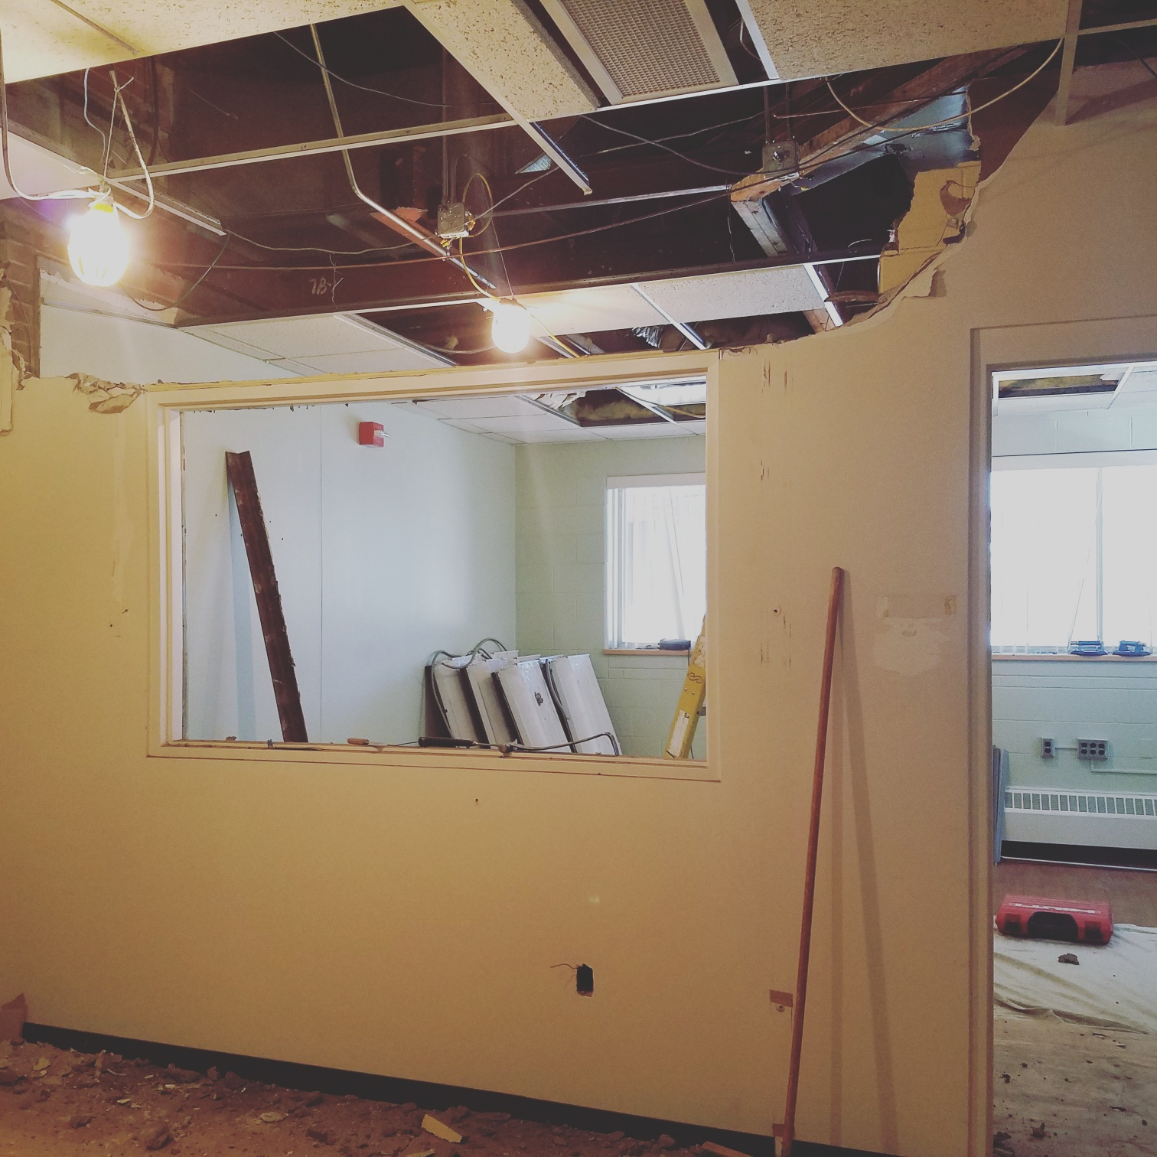
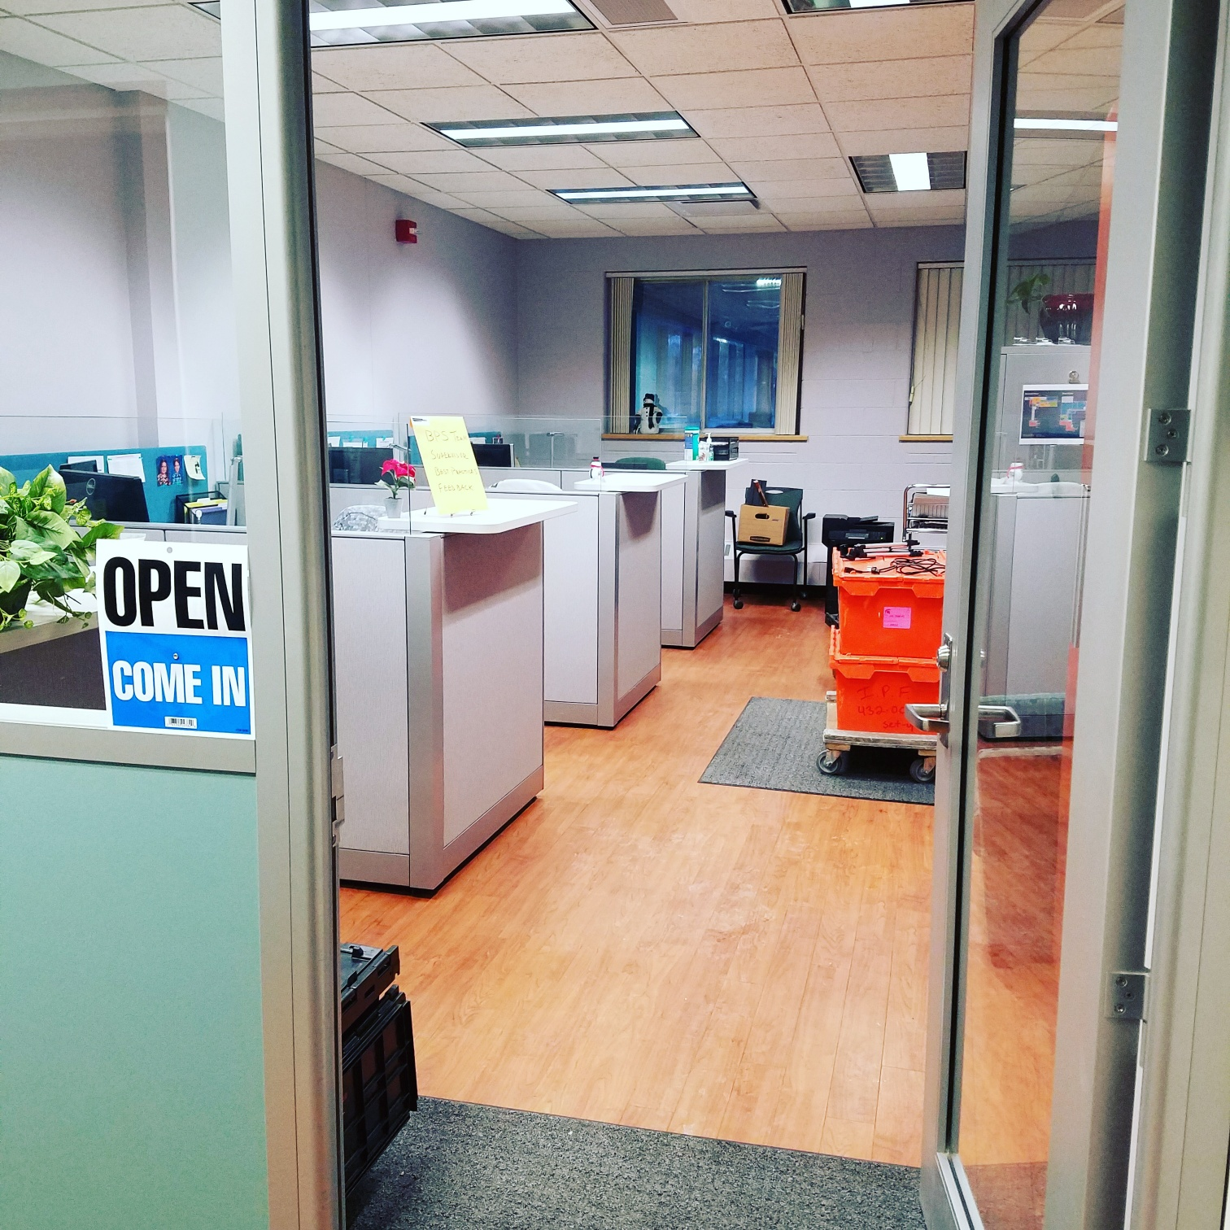
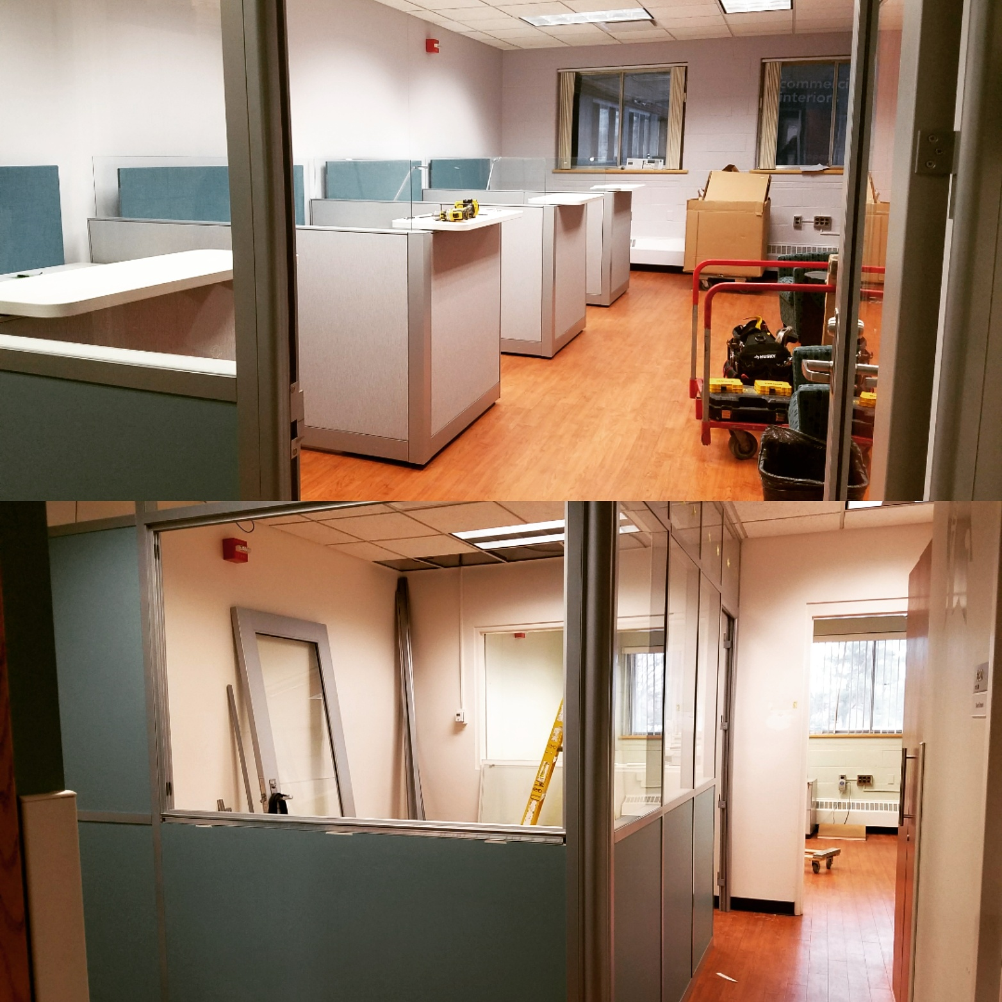
Formation of the Building Services Business Office
It all started with a plan…
Met with new Director on his first day
Presented idea, data, and business case for formation of the a centralized office to support all of Building Services
  Discussed previous inefficiencies
  Went through the proposed organizational changes
  Determined efficiencies
  Presented location options
Approval granted!
Renovation began

Slide 13
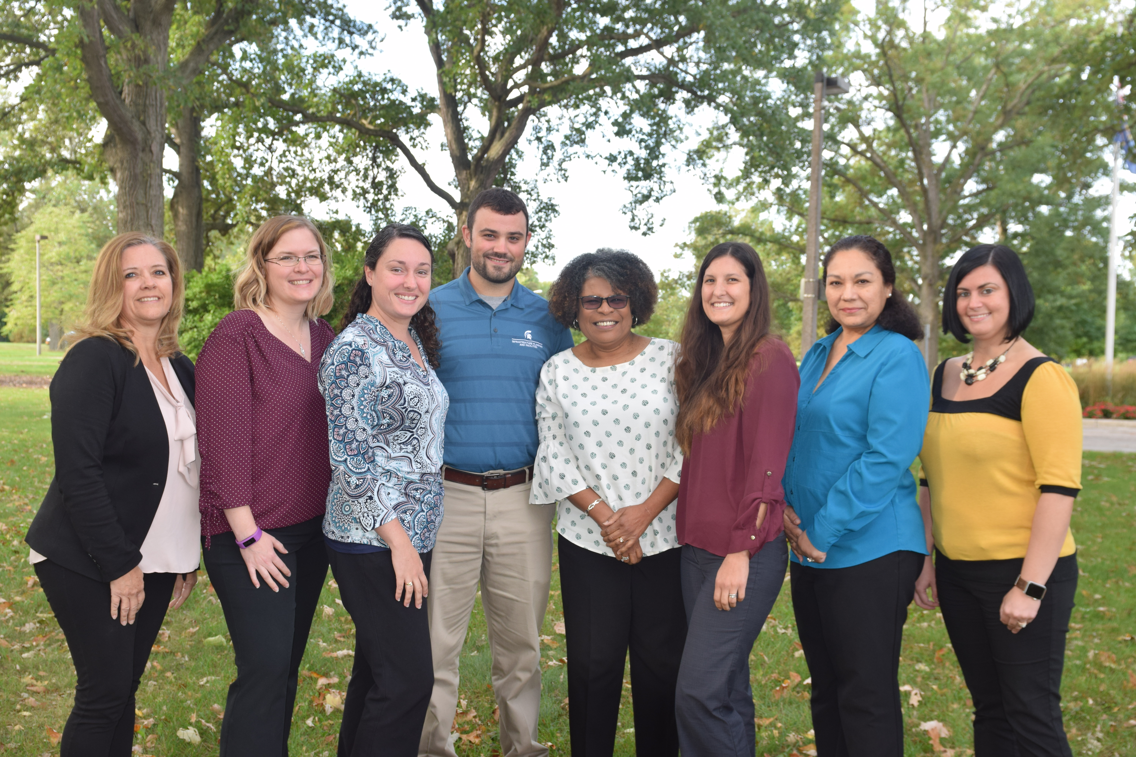
What happened next?
Reporting structure changes
Job duty assignment deep dive
I began reporting directly to the Director of Building Services
4 Administrative Assistants added to my reporting line
2 additional Operations Coordinators added to reporting line
Reviewed list of previous job assignments
Met with all staff members and asked the following questions:
  What do you like to do?
  What do you least enjoy doing?
  What would you like to be backup for?

Slide 14
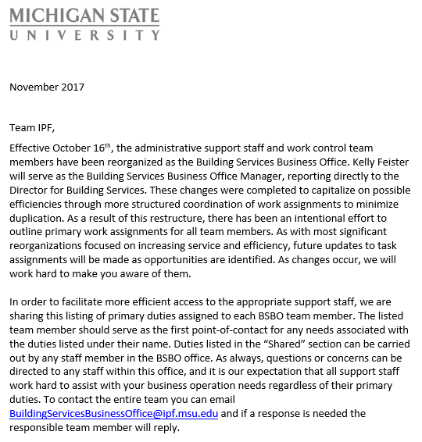
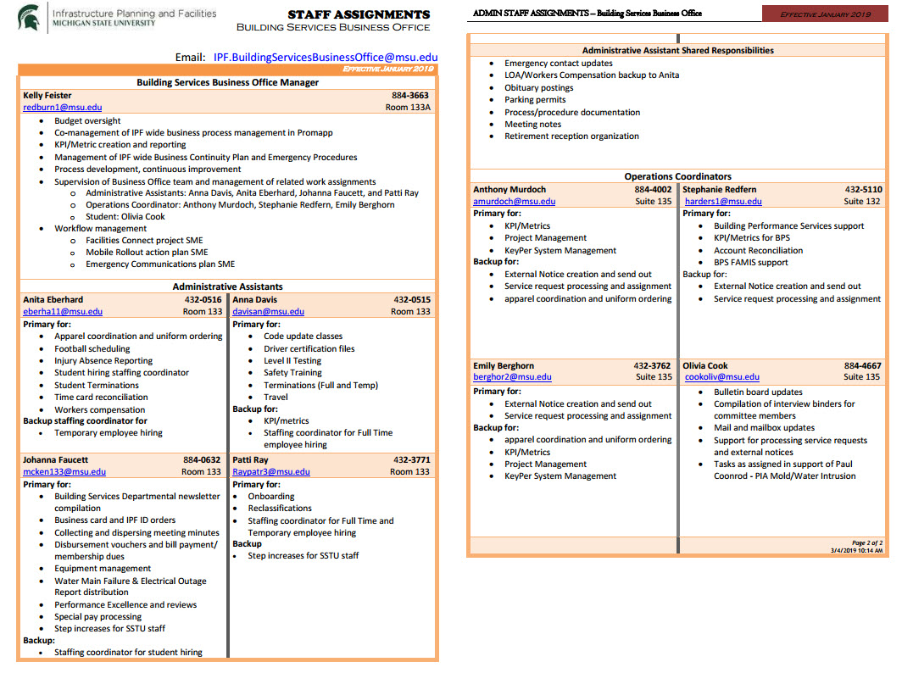
Updated job duties

Slide 15
Focus on process
Current state evaluation
Process improvement initiative
Outdated processes and procedures
Changing technology
Staff turnover
Organizational wide process improvement co-led by myself and Danielle Hook
Implementation of Promapp as our unit wide process library

Slide 16

Focus on process continued
Expectations set around documenting processes and procedures
Implementation of cross-training for the respective teams
  Work Control
  Admin
Goal of going paperless

Slide 17
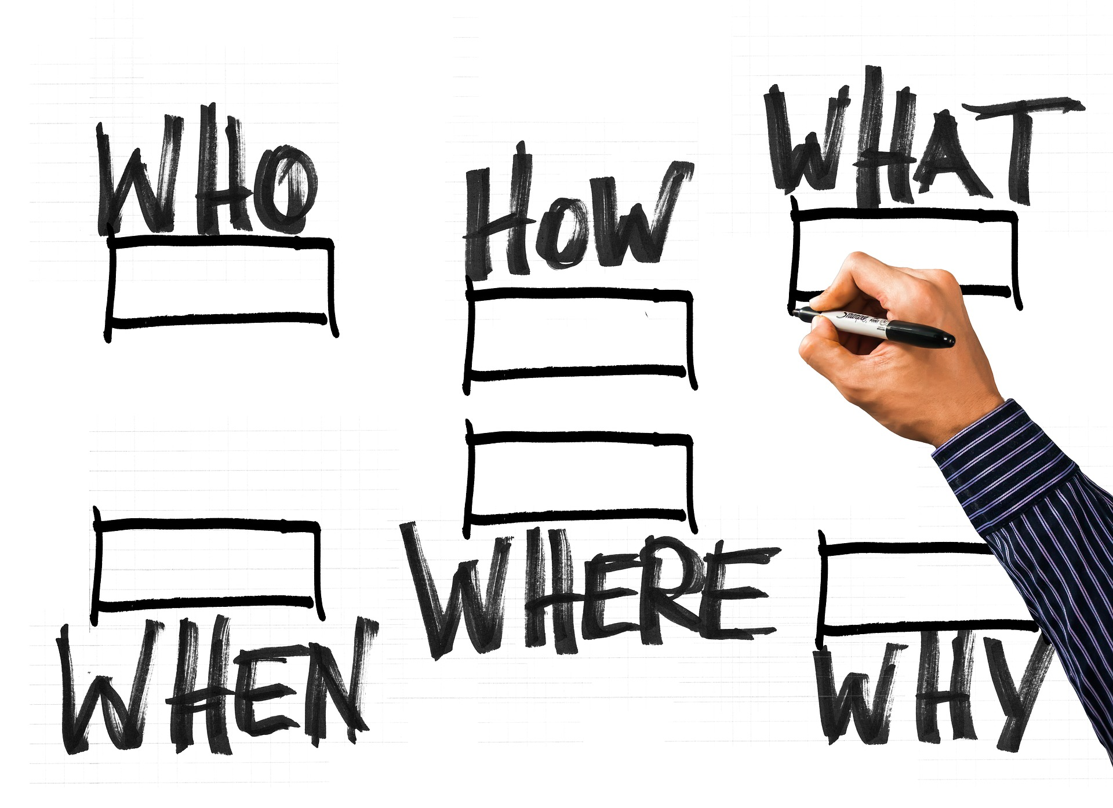
Focus on staff development
Emphasis placed on continuing education
  Life-long learner competency
  Encouragement of Certified Human Resource Specialist training for Admin team
Performance Excellence goals related to:
  Committee membership
  Job shadowing
Use of Employee Engagement Survey results
Involvement in departmental goal setting for the future

Slide 18
What about you?
Please use the chat function to answer the following:
  How often do you meet with your supervisor?
  If you are a supervisor, how often do you meet individually with your staff?

Slide 19
Use of the check-in meeting
By far the biggest benefit!
Implementation of weekly, bi-weekly, or monthly check-in (up to the staff member)
Ask a mix of questions:
  What is your biggest accomplishment this month?
  What is your biggest challenge right now?
  What things should we do differently?
  What resources would be helpful to you right now?
  What work tasks do you like to do?
  What work tasks do you not like to do?
  What are a few of your goals for the next week/month?
  For any of the items above, is there anything I can help you with?
  Is there something you need from me as your supervisor to meet you where you are or is there something I need to start/stop doing?

Slide 20
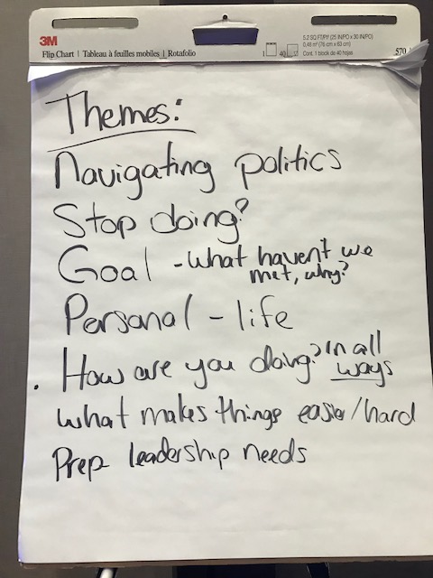
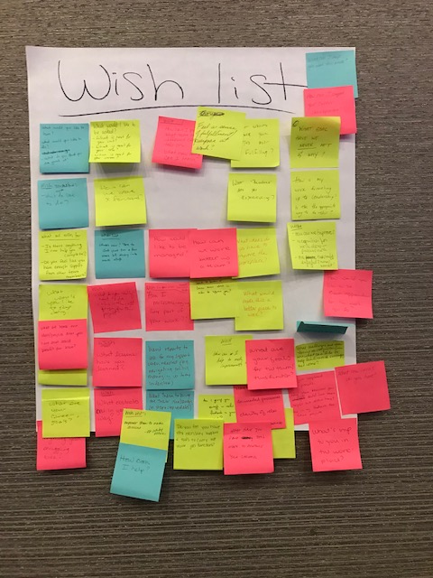
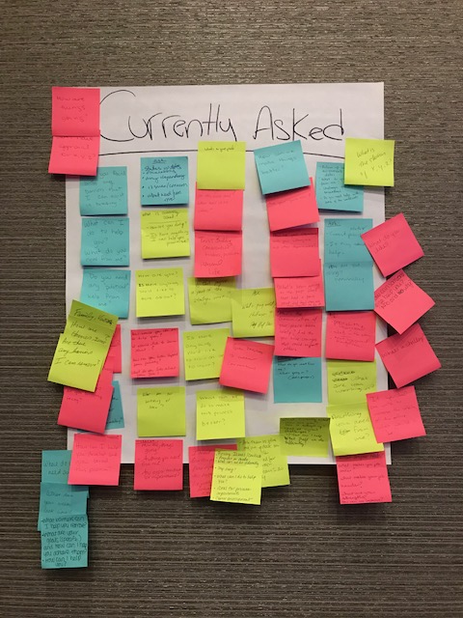
NCCI 2019 activity
Asked the following questions:
  What questions do you wish your supervisor asked you?
  What questions do you ask your staff?

Slide 21

What is happening today?
Today the Building Services Business Office is:
  Looked upon as a shining example of a well functioning support team
  Continually looking for new ways to improve
  Able to provide support when there are absences (work does not stop)
  Supporting over 300 employees daily
  Continuing to learn and grow

Slide 22
Questions?
Thank you!

Slide 23
Thank you for joining us today!
An evaluation survey for today’s Power60 has been sent via email. We greatly appreciate your feedback!
This recording will be available in NCCI Connect next week.
Upcoming Power60s:
February 25: Could Have Been an Email
March 25: Celebrating Failure: The Need for End-to-End Design

