Slide 1
Anatomy of an Org Assessment
The UCSD OSI approach for a data-driven org assessment
Brad Sollenberger, MLSSBB, MHA
Practice Director, Continuous Improvement
Operational Strategic Initiatives, UC San Diego

Slide 2
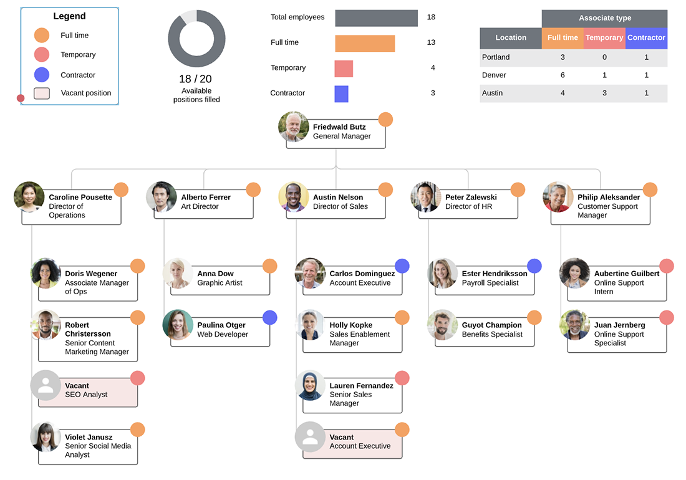
What is an Org Assessment?
A diagnostic tool to evaluate the current performance, capability, structure, and gaps

Slide 3
When to perform an Org Assessment
Internally Driven
Externally Driven
New Leadership
Updates to Mission or Strategic Goals
Customer-Service commitment
Budget justification
C-Suite or Provost mandated
Financial Response
Customer (Faculty or Student)

Slide 4
High-Level Overview of the Process What people think it is vs what it actually is
Comprehensive Interviews
Peer/External Benchmarking
Analysis and Synthesis of Key Findings
Report and Recommended Actions
Data and Financial Analysis

Slide 5
Outcomes of an Org Assessment
Findings
Recommendations
Department and Unit performance (Not focused on individuals*)
Customer perceptions and gaps
Capabilities or gaps in skills/knowledge
Overextensions and untapped potential
Minor to significant
Prioritization of hires or resourcing
Merger or Org Chart restructure
Development opportunities for staff

Slide 6
First Steps – Preliminary Data and Financial Analysis
Financial Review
Department and Unit Staffing
Contracted Services
IT Licenses and Operational Contracts
Existing Surveys (If available)
Review of customer and internal staff sentiment
Current and Past Org Charts
For assessment of turnover
Previous re-organizations
Notes:
In both cases, multiple years is helpful for trend analysis

Slide 7
Example: Staff@Work Survey for Business Offices

Slide 8
Systemic or Localized?
National Benchmarking – ACGME Survey for Residency Programs
Key Takeaway: Identify local vs systemic issues as early as possible to appropriately scope the engagement and manage sponsor expectations.
Prioritize or address the localized issues first, then consider becoming a leader in resolving systemic issues.

Slide 9
Example: Budget Review
Personnel trends
Non-personnel opportunities
The financial themes and the verbatim themes
Notes:
Meetings and travel reduced, then Professional Services reduced. Did reduction in travel reveal waste in professional services? What impact did the budgeted reductions have on performance?
Fairly stagnant personnel costs – follow up question, what staff did you ask for? Did you get it?
They’ve had personnel requests for years and never get it. This established the parameters later for recommendations – is new staffing realistic? No, so I need to find opportunities for aptitude within the current staff, or role modifications, to satisfy needs of the department.

Slide 10
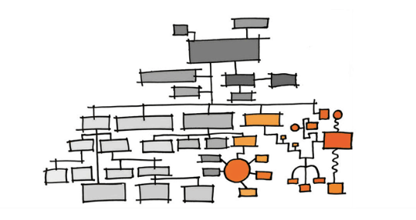
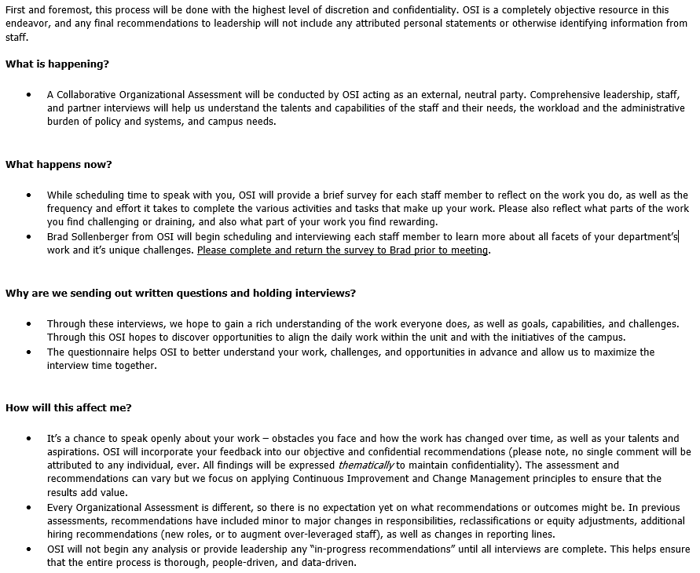
Interview Phase Strategies
Sponsor Interview
Create an interview/survey list
Leadership
All staff or sample?
Customer sample set for interviews, focus group(s), or survey?
Design and proctor a pre-interview questionnaire/survey
Develop Interview Questions
Align with Sponsor goals
Tip: Write 1 or 2 sentences on what you hope to gain from the question. What kind of analysis can you draw from it?
Best practice: Over-communicate
Interview Direction
Partners, Customers and external cohorts to survey, focus group, or interview

Slide 11
Question Examples
Question for Staff
“Executive Assistant, describe working with policy analysts. If an analyst, describe the times you’ve needed to work with the EA’s.”
To get a better understanding of where EA work ends and where Analyst work begins. Useful to make recommendations on types of work at the appropriate levels. It will also may reveal any personal conflicts.
Questions for Supervisors/Leaders
If you had 2 free hours a week suddenly available, what would you work on (or is back burner)?
This is the “opportunity cost” of this effort
What skill set is missing that would help you the most?
Framing gaps as “skill sets,” and not positions, can help isolate the true needs
Best practices: Double-up interviewers. No back-to-backs.

Slide 12
External Benchmarking
What are y'all up to?
Define characteristics of the “apple” and select
Public, research university
Part of a large, campus system
Academic Medical Center
Findings from External Benchmarking alone should not support change in structure or staffing
Should be used as a validating source or alternative scenarios
Gain agreement from sponsor to share (limited) findings
Tip: Wayback Machine is your friend

Slide 13
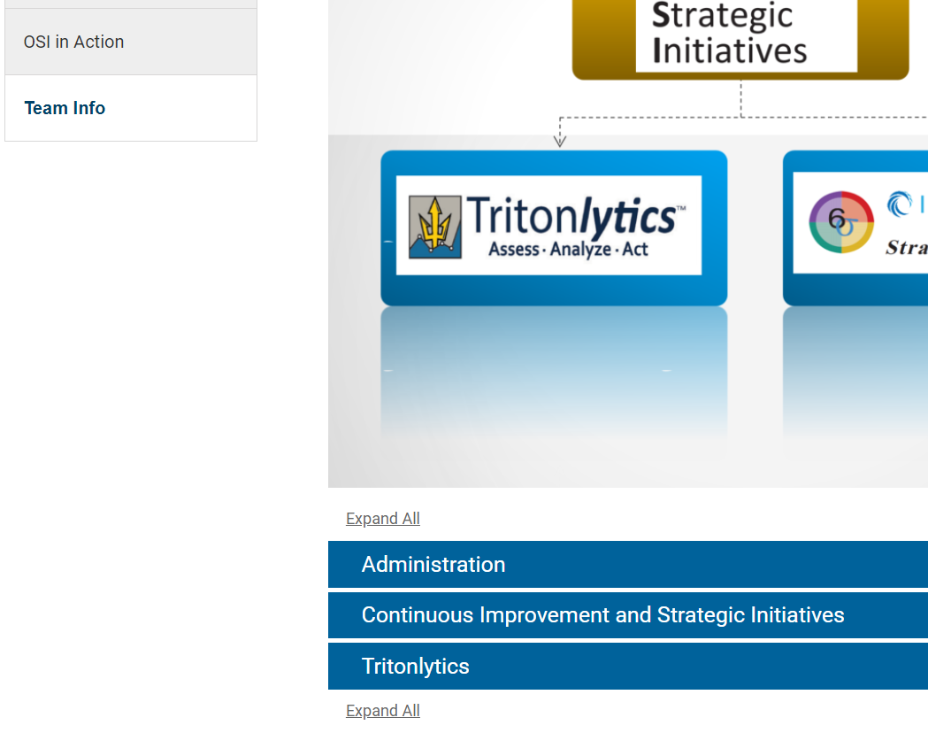
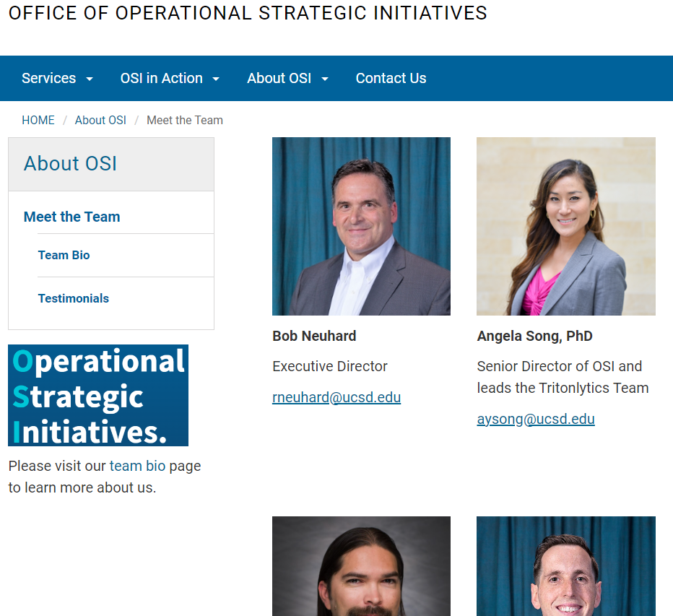
2019
FTE: 19
2023
FTE: 20
~20% turnover
Notes:
This can be used for internal or external benchmarking where information can’t be provided or is too sensitive to ask for.

Slide 14
Analysis and Synthesis of Findings
Organize by
Relevant sponsor interests
Major
Moderate
Uncovered findings
Major
Moderate
Minor themes/findings
A high quality organization of findings will enable a strong, coherent recommendation summary later.
Best Practice: Don’t review any interview notes until all interviews are complete
Notes:
Reviewing after complete will help preserve your objectivity as an interviewer, and soften biases by the time the analysis phase is underway

Slide 15
The answer to the question you’re all here for…

Slide 16
Example analysis: Internal Comparison (HR Hires and Staff)
 | Dept 1 | Dept 2 | Dept 3
Staff New Hires (2021) | 47 | 235 | 140
HR Unit FTE | 3.0 | 4.0 | ~8.0
 | Dept 1 | Dept 2 | Dept 3
Student Hires (2021) | 290 | 679 | 996
HR Unit FTE | 2.0 | 2.0 | ~7.0
16

Slide 17
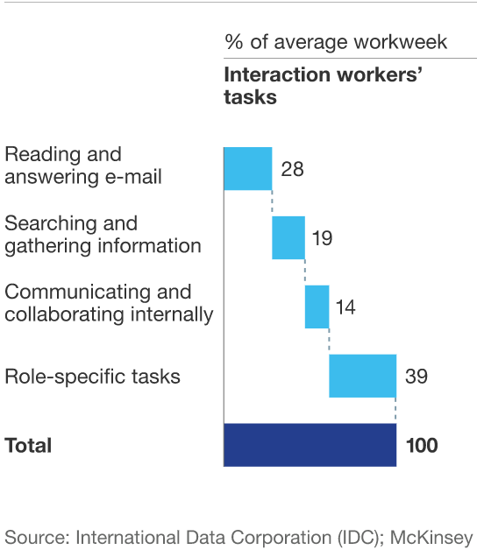
Capacity Analysis Approach – McKinsey Benchmark Study
Email, file folder searching, tracker updates, etc. variables isolated utilizing productivity benchmarks (IDC and McKinsey Global Institute analysis)
Allows for strict role-specific task analysis
Role-specific tasks confined to a 3.12 hours/day
Notes:
KEY TAKEAWAY: This analysis is very generous towards staff experience.

Slide 18
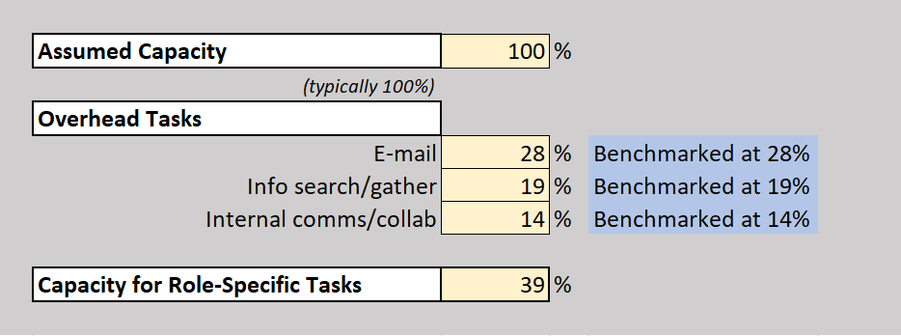
Project Portfolio Analysis – Transactional Staff
Create a list of transactional processes
Perform a time study of processes
Source volume data
Utilize takt time to determine if capacity excess or deficit

Slide 19
Recommendations for New Hiring
Capacity Analysis Findings
BO2
(HR) Staff: Sufficient
(HR) Student: Sufficient
AP: Insufficient
Fiscal: Sufficient
BO2
(HR) Staff: Inconclusive
(HR) Student: Insufficient*
AP: Sufficient
Fiscal: Sufficient

Slide 20
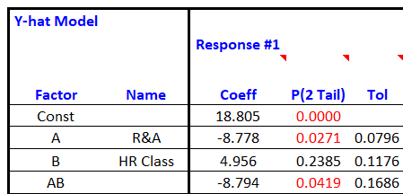
What if the work is contextual, not transactional? Recommendations for PM Resourcing
Results​
Regression Analysis
The classification of the “Responsible” person (or Project Lead) was not a significant factor in time to completion​
Dual RACI roles was significant
Analyst-led projects lowest time to completion
Recommendations​
Responsible =/= Accountable​
Keep leadership in A, not R​
Will preserve their time for “top of license” work, and will optimize Analysts results​
Historical piecewise can provide a starting point for project timelines​

Slide 21
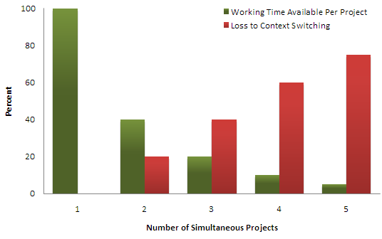
Consideration for PM resourcing
Useful for establishing ideal PM workload
Budgeted projects/ initiatives x Est time to complete (see previous slide) and compare against available resources
Are you under or overstaffed?
Does it make sense for hiring or contract?
Source: Quality Software Management Systems Thinking, p.284

Slide 22
Executive Coaching Recommendations - Ideal Project Support Scenarios
Deputy Chief of Staff
Complex Projects – Consistent flux, no right answers but patterns emerging.
Chaotic Projects – “Unknowables,” More decisions to make than time to think, High tension
.
Project Policy Analyst
Complicated Projects – More than 1 right answer, cause-effect discoverable, fact-based management.
Special Assistant / Exec. EA
Clear Projects – Patterns, consistent events, clear cause-effect relationships.
*Stretch assign low risk, complicated projects
(New) PPA4 or Org Consultant 4
Chaotic, Complex, and Complicated Projects. If anticipating high demand of Chaotic/Complex projects, consider Org Consultant 4. If project demand is primarily Complicated and some Complex, consider hiring a PPA4
Notes:
Projects like the Shared Drive Organization project is better suited for BOC or EA on a stretch assignment (positioning for the revised Special Assistant role)

Slide 23
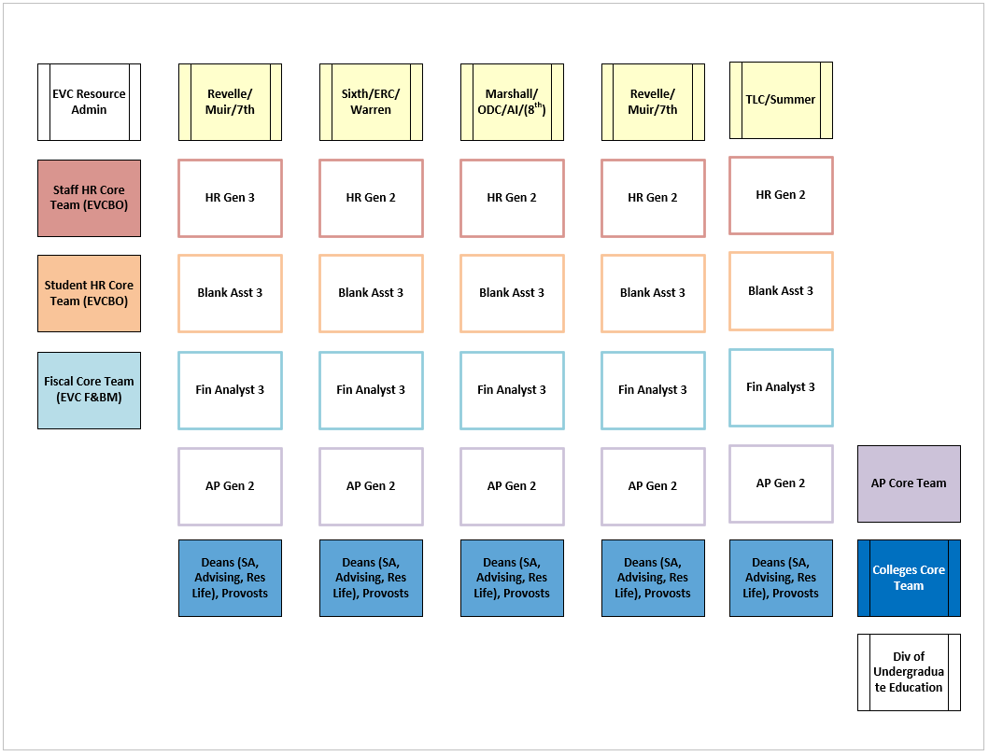
Recommendations for New Hiring
Division 1 Director
Team Portfolio
Team Portfolio
Team Portfolio
Team Portfolio
Team Portfolio
Recommendation
Merge two teams – different seasonal volumes would allow for flex support
New Matrix-Model approach for shared service support of Colleges
Volume based assignments for customer teams
Justifications
Organic, informal interactions have increased over the years
Customers increasingly interested in “one-stop shop” for all services
Maintain traditional, functional management with benefit of de-siloed collaboration
Customer 1
Customer 2
Customer 3
Customer 4
Customer 5
Division 2 Director

Slide 24
Analysis of Key Findings and Report
Preserve confidentiality
Major and minor themes
Validate everything
If interviews indicate understaffing, do staffing comparisons validate this?
If customer focus groups indicate low satisfaction, do surveys validate this?
Full report and socialization deck/report

Slide 25
Helpful Tips
Confidentiality and objectivity are above every other principle
Respect for the worker
Empathy is important to establish change management success later
Coach the sponsor for radical transparency
Take what the assessment gives you
Invite yourself to the socialization sessions
Soft Skills for Success

Slide 26
Thank You [Questions?]
Brad Sollenberger
Practice Director, Continuous Improvement
Office of Operational Strategic Initiatives, UCSD
bsollenberger@ucsd.edu

