Slide 1
Pathways and Processes
Developing JHU’s DEI Strategic Plan
Dr. Emil L. Cunningham, Assistant Vice Provost for Diversity and Inclusion & Deputy Chief Diversity Officer, Johns Hopkins University
Erin Fox, PMP, Senior Manager, Strategic Initiatives, Johns Hopkins University
Notes:
1

Slide 2
No slide title
“…the most important capital that any university has, human capital1.”
¹ Young, Anderson, & Stewart (2015)
Notes:
2

Slide 3
Agenda
Session Objectives
Planning to Strategic Plan
Strategic Planning
Refining the Plan
Building Capacity
Questions
Notes:
1

Slide 4
Planning to Strategic Plan

Slide 5
Planning to Strategic Plan
Admin 101 Series: How to Plan for Strategic Planning*
Convene a pre-planning group
“Establish an agreed-upon constitution of how committees will be run”
Choose committee leadership wisely –
Expertise
Objective perspective
Interpersonal skills
Available time
Timely
Support the people leading these efforts – work release
*Perlmutter, B.D., 2019 Admin 101: How to Plan for Strategic Planning. The Chronicle of Higher Education. Retrieved rom from https://www-chronicle-com.proxy1.library.jhu.edu/article/admin-101-how-to-plan-for-strategic-planning/
Notes:
3

Slide 6
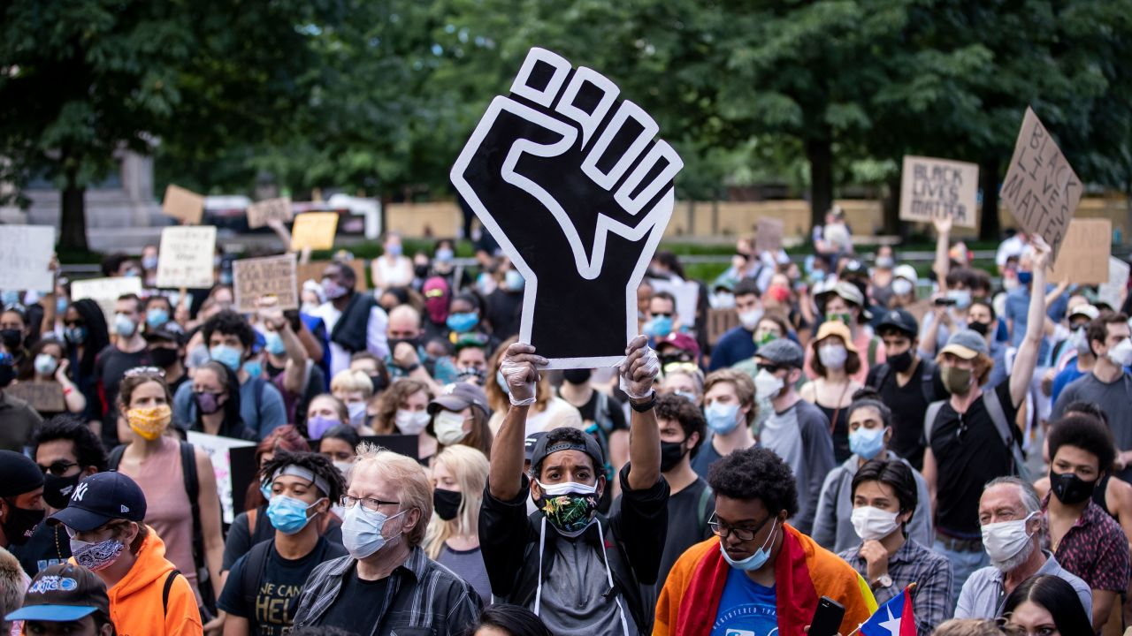
Planning to Strategic Plan: Context
Initial Roadmap was concluding
New Chief Diversity Officer
Beginning months of the COVID-19 pandemic
A moment of racial reckoning in America
https://www.cnn.com/2020/09/04/us/blm-protests-peaceful-report-trnd/index.html
https://news.yale.edu/2021/10/11/widespread-masking-encourages-others-wear-masks
Notes:
2

Slide 7
Planning to Strategic Plan: Our Initial Roadmap Process
Identify Roadmap 2020 Task Force members
Charge meeting
Dual retreat with Diversity Leadership Council (DLC) to identify work groups
Formation of work groups
Work Groups develop recommendations
Work with University Leadership to create pillars based on recommendations
Open comment and socialization period
Continued refinement
Endorsement by Board of Trustees
Rollout DEI Strategic Plan

Slide 8
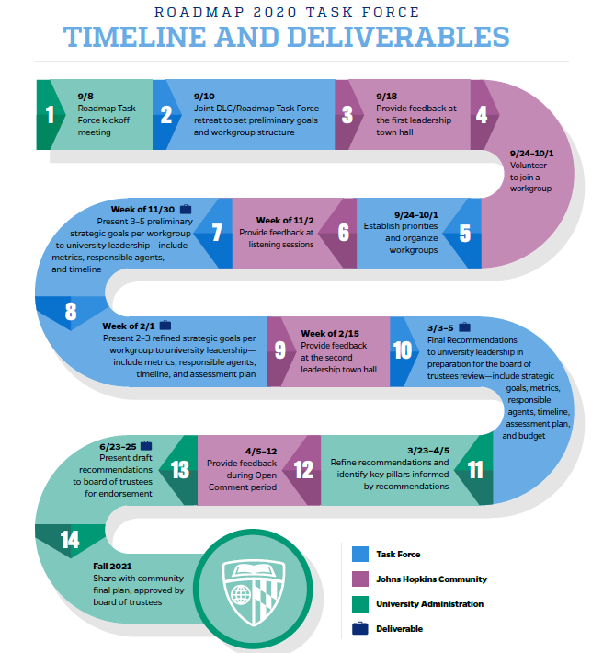
Roadmap 2020 Task Force Timeline and Deliverables

Slide 9
Planning to Strategic Plan: Our Initial Roadmap Process
Primary Objective
Develop a set of recommendations with measurable goals and accountabilities that highlight new approaches and collaborations within and beyond our academic community aimed at ensuring more concrete progress over the next five years.

Slide 10
Planning to Strategic Plan: Identifying Task force Members
Group work
Who, or what offices, would you invite to serve as co-chairs of select task force workgroups?
Who, or what office representation, would you invite to be members of the task force work groups?
What methods of solicitation would you use to invite either population of work group members?
Notes:
5 - minutes

Slide 11
Strategic Planning

Slide 12
Strategic Planning
Admin 101 Series: How to Manage the Strategic Planning Process*
Strategic Planning Goals
Realistic objectives that can be accomplished within a set period of time.
Arguments, values, and rationales behind those objectives.
Metrics to mark their success or progress.
Resources (money, people, materials, facilities) to reach and sustain the objectives.
Key Points
Resist the urge to micromanage.
Make sure the strategic planners are trusted on the campus.
Plan around your highest priorities.
Err on the side of specificity.
Can you really afford what you’re proposing?
Resolve the contradictions in the final version
*Perlmutter, B.D., 2019 Admin 101: How to Manage the Strategic-Planning Process. The Chronicle of Higher Education. Retrieved from https://www-chronicle-com.proxy1.library.jhu.edu/article/admin-101-how-to-manage-the-strategic-planning-process/
Notes:
3

Slide 13
Strategic Planning: Roadmap 2020 Task Force
Task Force Members
Workgroups
Senior Institutional Leaders (e.g., Vice Provosts, Vice Presidents, etc.)
Deans
Faculty (including department heads/chairs)
Staff
Students (undergrad and graduate students)
Alumni
Postdocs
Community partners
Institutional Accountability
Student Success
Graduate
Undergraduate
Faculty Diversity Initiative
Pathways to Staff Advancement
Community Engagement
Alumni Engagement
Training and Development

Slide 14
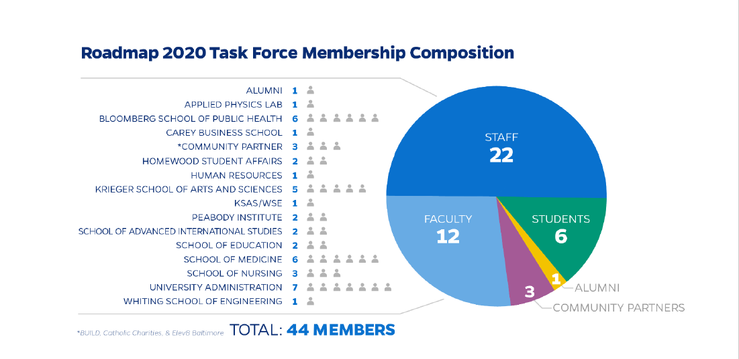
Strategic Planning: Engaging Affiliates
Affiliation
Division
Community
Leaders

Slide 15
Strategic Planning: Task Force Guiding Principles
Radical transparency
Data-driven
Targeted resource allocation
Systems-based approach
Hearts and minds
Institutional accountability
Bold/innovative/deeper
Clear metrics and Outcomes
Less is more

Slide 16
Integrating Systems and Design Thinking
Systemic Design Toolkit (Kristel van Ael of Namahnlick)

Slide 17
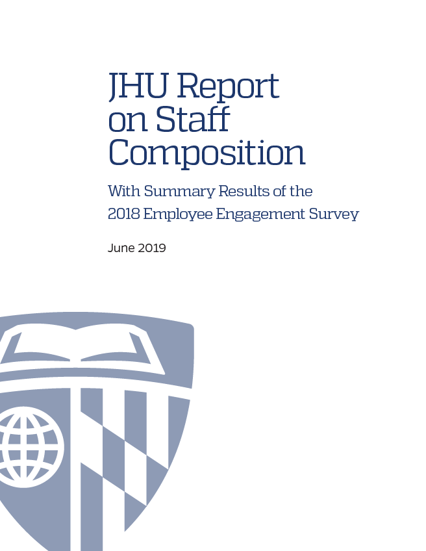
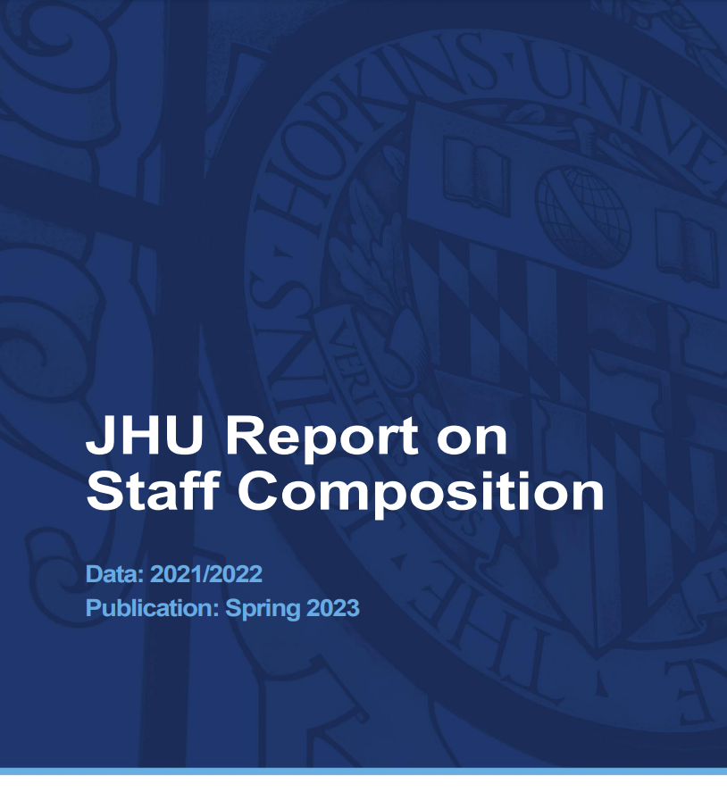
Strategic Planning: Listening To the System – Staff Development
Staff composition reports
Public documents that examine the composition of job classification and division by demography
Internal efforts
Produced results, but more effort was needed
Similar to our peers
But not the make-up of Baltimore
Notes:
External Models - Netflix

Slide 18
Strategic Planning: Understanding the System - Addressing Root Causes
Faculty Diversity
Many in the STEM fields argue the pool is small (# of PhDs in STEM fields per year)
If the pool is small (root cause), there are multiple solutions
Make the pool bigger (VTSI)
Make the pool more robust
Invest in growing the pool
Led to dual investments into Graduate and Faculty development
Increased opportunities for scholars from underrepresented backgrounds
Increased Ph.Ds granted to scholars from underrepresented backgrounds
Increased pool of faculty from underrepresented backgrounds
Increased opportunities for development and retention for faculty from underrepresented backgrounds
Increased opportunities for faculty from underrepresented backgrounds to collaborate with students from underrepresented backgrounds

Slide 19
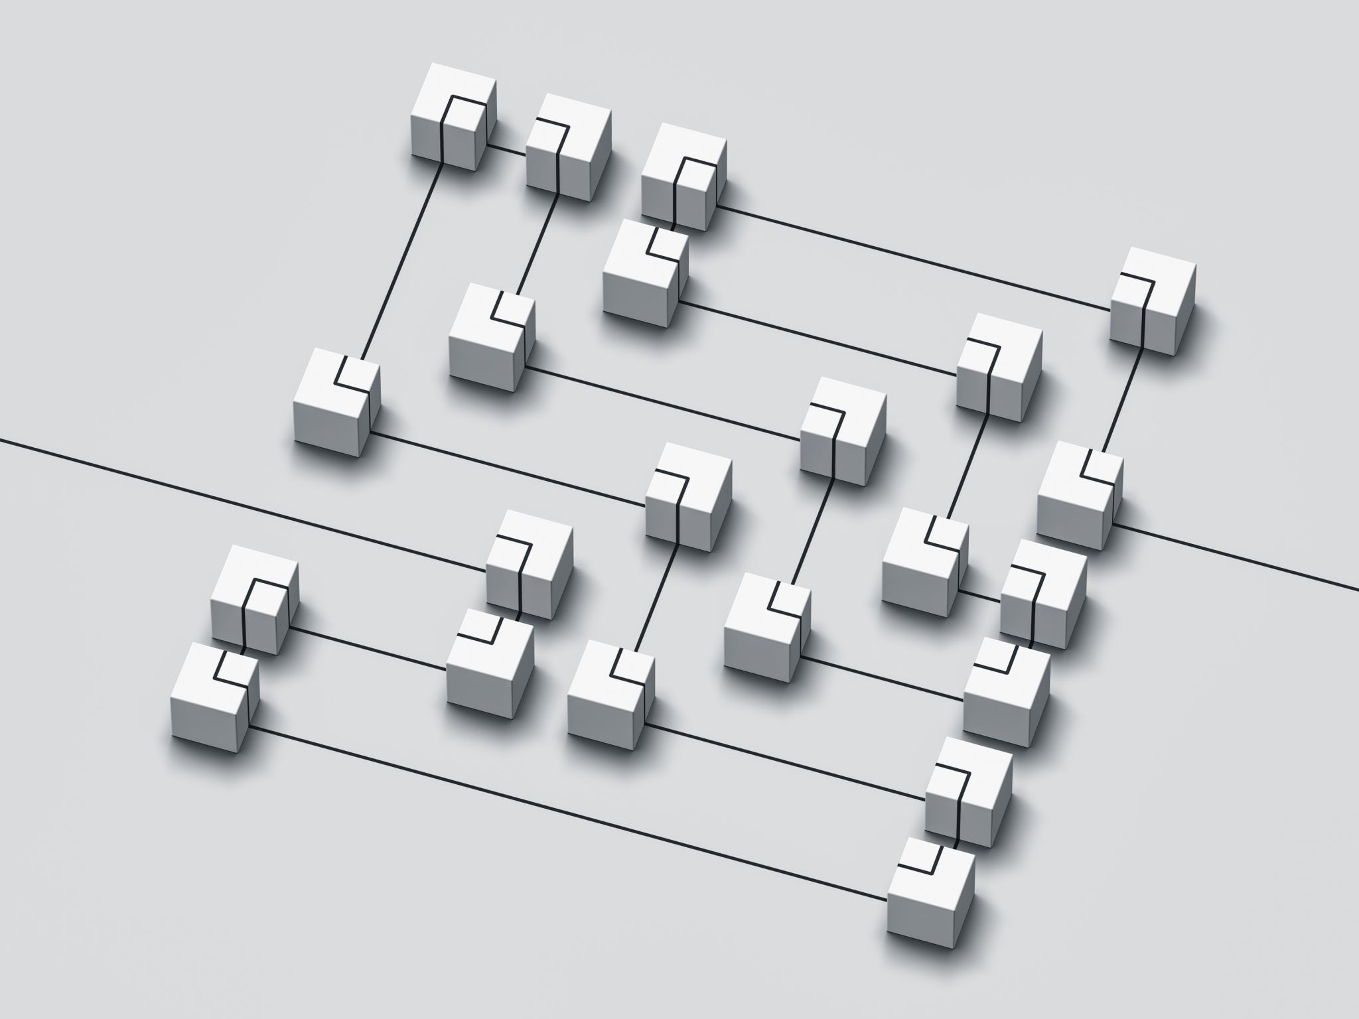
Strategic Planning: Identifying Your Systems
Group Work
What systems could your strategic plan help address?
Are there easily identifiable root cause issues (e.g., barriers to inclusion) within these systems?
What are the intersections of your institution's DEI principles with the systems and root cause issues you've identified?
Notes:
5 – minutes
If you don’t know the root cause of an issue, what data do you need to better understand the issue?

Slide 20
Refining The Plan

Slide 21
Refining the Plan: Task Force Review Cycles
Cycle 1
3-5 preliminary goals per workgroup
Include metrics
Identify responsible agents
Offer anticipated timeline
Cycle 2
2-3 refined goals per workgroup
Include metrics
Refinement of responsible agents
Clearer delineation of timeline
Recommend assessment plan
Cycle 3
2-3 finalized goals per work group inclusive of:
Defined metrics
Identified and named responsible agents
Explicit timeline
Robust assessment plan
Anticipated budget

Slide 22
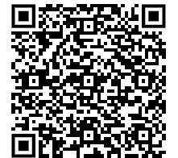
What we received... Roadmap Task Force Recommendations—Disposition in Second Roadmap Goals
https://diversity.jhu.edu/second-jhu-roadmap-on-diversity-equity-and-inclusion/roadmap-task-force-recommendations-disposition-in-second-roadmap-goals/

Slide 23
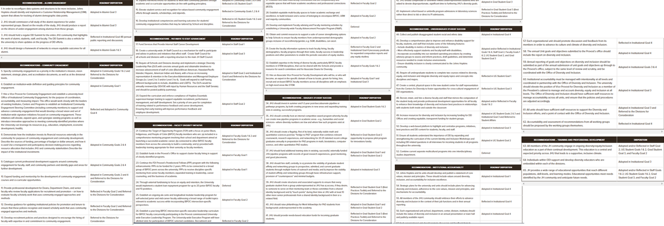
No title slide
65 Recommendations!!!!!

Slide 24
Refning the Plan: Coming to a Consensus
Group work
How would you whittle this list down?
Who do you need input from?
How would you solicit feedback?
Notes:
5 minutes

Slide 25
Refining the Plan: Identifying and Prioritizing Strategic Planning Efforts
Community feedback
Focus groups and interviews
Voting on priorities
Feedback on draft plan
Evidence/Research-based
Leadership and Institutional Priorities
Political Environment
Data
Composition Reports
Survey results
Community Feedback
Data
Institutional Priorities
Final Goals

Slide 26
Refining the Plan: Commitment without currency...
Putting our money where our heart is
Key Initiatives
Vivien Thomas Scholars Initiative ($150M)
Target of Opportunity Program => Fannie Gaston Johannson Faculty of Excellence Program ($50M)
Staff Career Architecture ($10M)
DEI Graduate Student Ambassadors ($TBD)
Graduate Student Relocation funds ($TBD)
Community Academic Partnerships ($5M)
Additional fund requests
Student DEI lifecycle ($TBD)
Student diversity and inclusion space ($TBD)
Building DEI Staffing Infrastructure
4 Academic DEI Deans
12 new central DEI office positions
4 new student DEI focused positions
2 new operational DEI focused positions with alignment to central DEI office
Financial Accountability
Institution-wide DEI spend tracking
Roadmap-related spend tracking
Notes:
We had a plan without the process for financial investments
Commitment without currency is counterfeit

Slide 27
Building Capacity
Leverage Existing Resources
Develop New Resources
Continual Advocacy
VectorStock.com/9645765
Notes:
We now have goals!
But how do we get there?
Existing Resources
New Resources
Now we have resources!
But what to do with them?
D&I Practitioners Group
Diversity Leadership Institute
Developing local and central infrastructure
Learning and Support
Being in the room
Advocacy
Sharing successes and needs

Slide 28
Questions
rd.com/list/mensa-quiz/

Slide 29
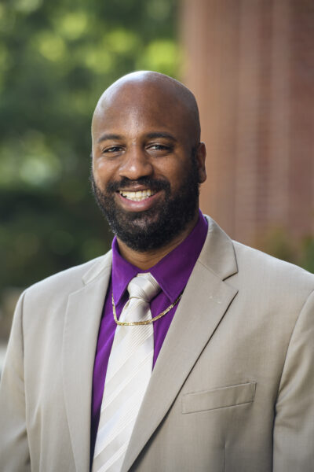
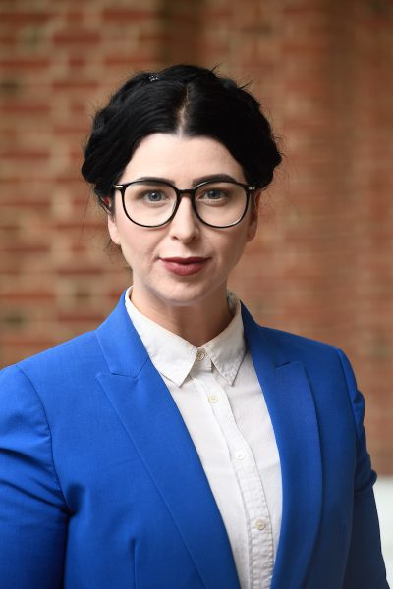
Thank you!
Dr. Emil L. Cunningham
Assistant Vice Provost for Diversity and Inclusion & Deputy Chief Diversity Officer
Johns Hopkins University
emil1@jhu.edu
Erin Fox, PMP
Senior Manager, Strategic Initiatives
Johns Hopkins University
erinfox@jhu.edu

