Slide 1
Scaling Strengths Based Development in the Changing Landscape of Higher Education
Danielle Hook
Learning & Development Manager
MSU Human Resources
Organization & Professional Development

Slide 2
Good morning
Please add your name to a table tent along with your top 5 strengths
These can be found in the
Signature Themes Report
&
Theme Insights Report

Slide 3
Warm up & Introductions
Please share the following about yourself:
Name & role
First impressions of the assessment or your results, for example:
Did anything surprise you?
How was your experience while taking the assessment?
How do you feel about your results?
Any lingering questions?

Slide 4
Today’s Agenda
8:30 Welcome and introductions
8:45 Context and background
9:00 Experiential Learning: Identity & Maximize Your Strengths (Individuals and Teams)
12:00 Lunch (boxed lunches will be provided)
1:00 Experiential Learning: Strengths Based Leadership (Leaders)
3:00 Review and reflect
3:25 Wrap up and resources

Slide 5
Learning Outcomes
Evaluate the use of the Clifton Strengths framework as a developmental program for support staff, teams, and leaders in higher education.
01
Explore the importance of a strengths-based approach to development in support of institutional change management and strategic planning efforts.
02
Reflect on individual talents and strengths utilizing the CliftonStrengths Framework.
03

Slide 6
Michigan State University
12,000+ support staff, faculty, and staff
50,000+ students
Leadership turnover
Support staff turnover
2030 Strategic Plan
Challenging times

Slide 7
Evolution of CliftonStrengths at MSU
Individual departmental initiatives
University level program offering (2018)
Program expansion (2022)
Cultural integration

Slide 8
Program Expansion
CliftonStrengths at MSU
Individuals
Teams
Leaders
Cross-Functional Teams
Communities of Practice
Unlock the Full 34
1:1 Coaching

Slide 9
Identify & Maximize Your Strengths
For Individuals and Teams

Slide 10
Course Objectives
Reflect on individual talents and strengths utilizing the CliftonStrengths framework.
Appreciate the diversity of talents and strengths amongst the team.
Communicate individual contributions, limitations, needs, and boundaries to other members of the team.
Evaluate the influence of the team’s strengths profile on the execution of work.

Slide 11
Overview of CliftonStrengths History & Assessment

Slide 12
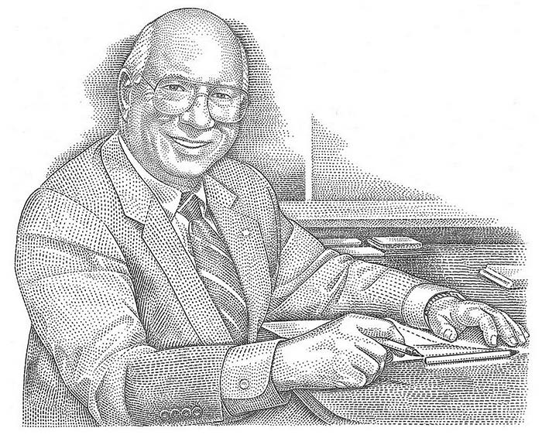
“What if we focused on what is right with people, rather than what is wrong with them?” – Donald Clifton

Slide 13
History of the Assessment
Created under the leadership of educational psychologist Donald Clifton
Worked with Gallup to develop Clifton StrengthsFinder as an objective measure of personal talent
Assessment has withstood a few evolutions, while delivering consistent results

Slide 14
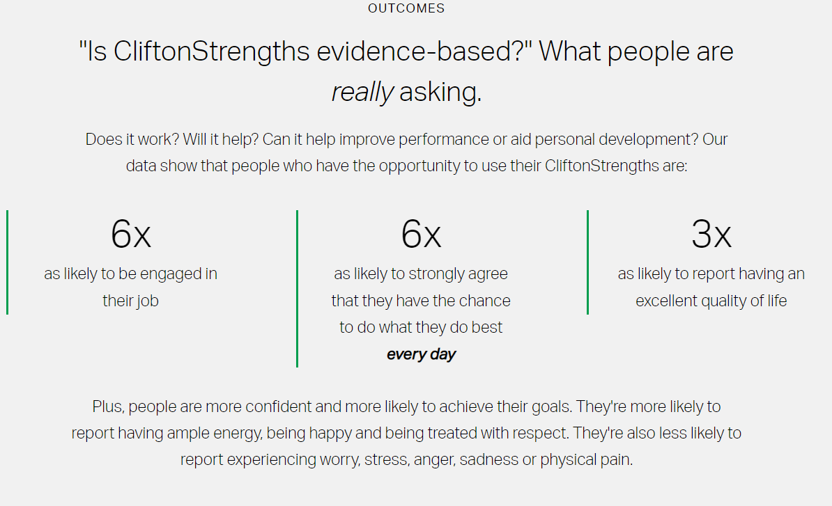
Notes:
https://www.gallup.com/cliftonstrengths/en/253790/science-of-cliftonstrengths.aspx

Slide 15
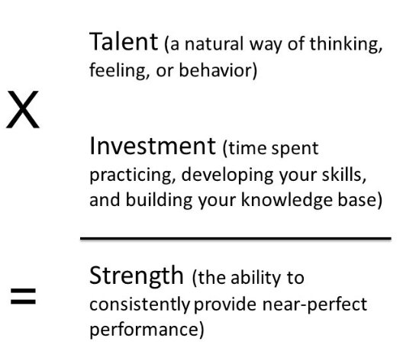
Key Definitions
Talent: A talent is a naturally recurring pattern of thought, feeling, or behavior that can be productively applied. It is also where strength begins.
Strength: A strength is the ability to provide consistent, near-perfect performance in a given activity. Strengths are produced when talents are refined with knowledge and skill. As you develop strengths by building on your greatest talents, achievements will follow.

Slide 16
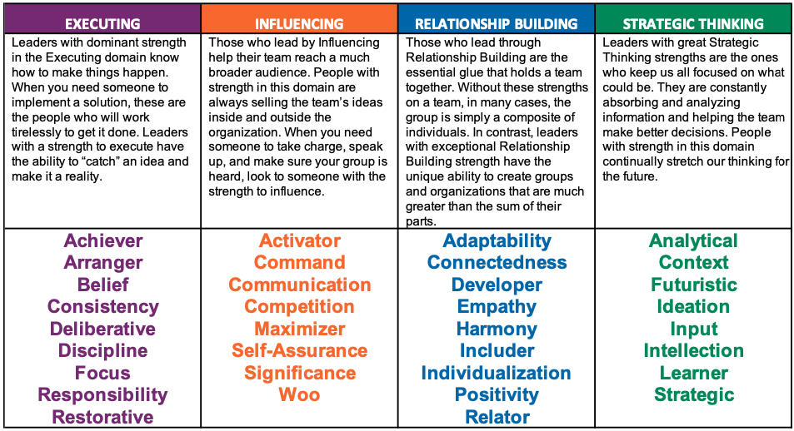
34 Strengths – Four Domains

Slide 17
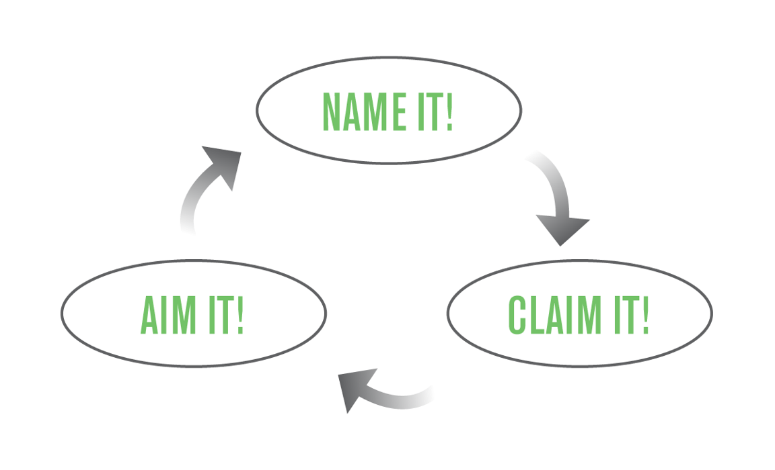
Your report is a beginning, not an end.

Slide 18
Name it!

Slide 19
Pre-work review
Select 2 different colored highlighters
Read through your Signature Themes report
In one color, highlight the statements, words, or phrases with which you identify or find most relatable
Using another color, highlight the statements, words or phrases that you are unsure of, that do not resonate or with which you cannot identify

Slide 20
Results Debrief
What did you learn while reading through the results?
Did any language jump out to you very accurate?
Did you reject or fail to connect with any of the language?
What questions do you still have?

Slide 21
Break

Slide 22
Claim it!

Slide 23
Strengths in Action
At your tables, discuss the following:
Where do you see your strengths showing up in your personal/professional life?
Are there activities you enjoy that engage multiple strengths at the same time?
How have your strengths helped you succeed in the past?

Slide 24
Balconies & Basements
The Balcony descriptors are those that sound like compliments. Balcony can also describe the use of a talent in a highly effective manner.
The Basement descriptors are the barrier labels, terms used when a talent is mistakenly devalued, dismissed, or understood as a weakness. Barrier labels prevent us from experiencing our full potential.

Slide 25
Perceptions & Expression
Themes are neutral, perceptions are not
We control our expression and our bias
Perception
Expression
Balcony
Basement

Slide 26
Break

Slide 27
The Best of Us

Slide 28
The Best of Us
You get the best of me when…
You get the worst of me when…
You can count on me to…
What I need from you is…

Slide 29
Love, Frustrate, Appreciate

Slide 30
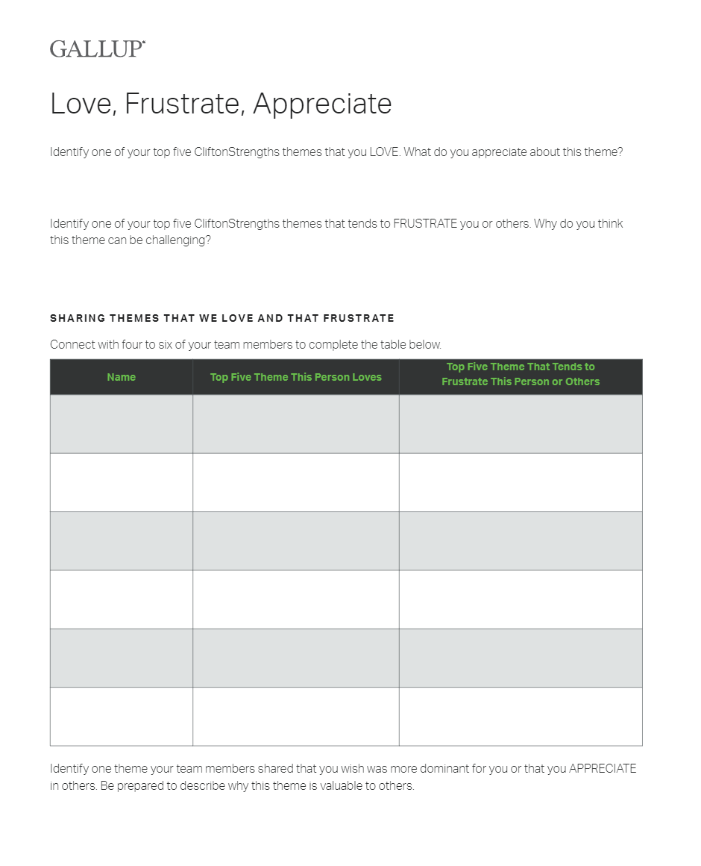
Pair
Share
Switch

Slide 31
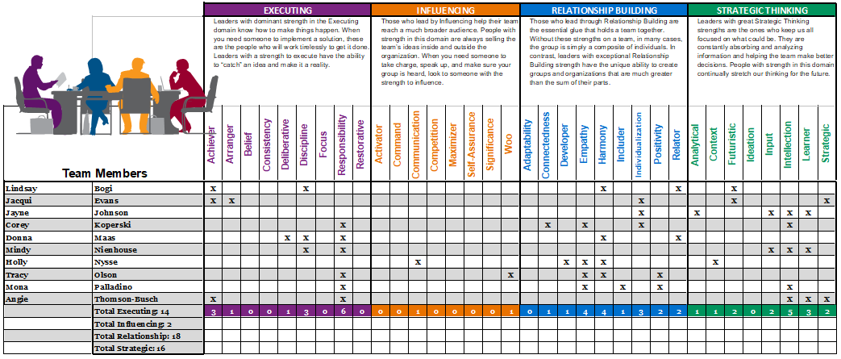
Team Strengths Map
What does the Team Strengths Grid say about the team?
What does the team do well?
How are we currently maximizing our talents as a team?
Which talents could we lean into to to positively impact current goals/challenges?
Where do we see powerful partnerships?

Slide 32
Lunch

Slide 33
Mid-Day Check In
How are you feeling about this material?
What questions can we answer?
Any key insights or takeaways?
Anything of interest we can explore further this afternoon?

Slide 34
Strengths Based Leadership
For Managers, Supervisors, Leaders

Slide 35
Course Objectives
Understand manager-specific strengths using the newly released CliftonStrengths for Managers Report.
Evaluate the needs of their team to identify strengths-based solutions and support.
Develop simple, actionable steps to enrich leadership practice with strengths-based behaviors, tapping into Gallup’s 7 Core Competencies of Transformational Leaders.

Slide 36
Reflection
How would you define Strengths-based leadership?
What might this look like in practice?

Slide 37
What is Strengths-Based Leadership?
Strengths-based leadership is the ability to identify and make the best use of your own and your team members' strengths. (MindTools)
The underlying belief that people have several times more potential for growth building on their strengths rather than fixing their weaknesses. (David Burkus)
Notes:
https://www.mindtools.com/pages/article/strengths-based-leadership.htm
https://davidburkus.com/2010/04/strengths-based-leadership-theory/

Slide 38
Benefits
Promotes delegation
Individualized recognition
Foster sense of mastery and purpose
Strategically align resources
Celebrate diversity, foster inclusivity
Enables targeted performance planning
Model cultural values
Increased performance
Lower attrition

Slide 39
The Needs of Followers

Slide 40
The Needs of Followers
Trust
Stability
Hope
Compassion

Slide 41
Trust
Foundation for leading.
Honesty, clarity and behavioral predictability.
Credibility + reliability + intimacy
BRAVING Trust (Brene Brown)
Boundaries
Reliable
Accountable
Vault
Integrity
Non Judgement
Generosity

Slide 42
Braving trust video?

Slide 43
Compassion
Caring about your followers holistically.
Seeing them as more than just their ability to perform.
Share their own struggles and accept the same honesty from others.
Share human self.

Slide 44
Stability
Creating space where people feel safe.
They can depend on you to answer their questions, hear their ideas and address their concerns.
Puts emphasis on the current moment.
Be the calm.
Communicate to reduce storytelling and ambiguity.
Keeping people grounded in the here and now -- knowing they can count on you.

Slide 45
Hope
Encourage people to believe in a better future.
Hopefulness deals with the future.
People need to see that their leaders have a clear direction in mind.
Help followers feel more enthusiastic about the future.

Slide 46
Table Discussion
What is the role of leader in meeting these needs?
What barriers can we anticipate for leaders in meeting these needs?
Trust
Stability
Hope
Compassion

Slide 47
Break

Slide 48
Transformational Leadership Competencies

Slide 49
Transformational Leadership
Build Relationships
Lead Change
Think Critically
Communicate Clearly
Create Accountability
Develop People
Inspire Others

Slide 50
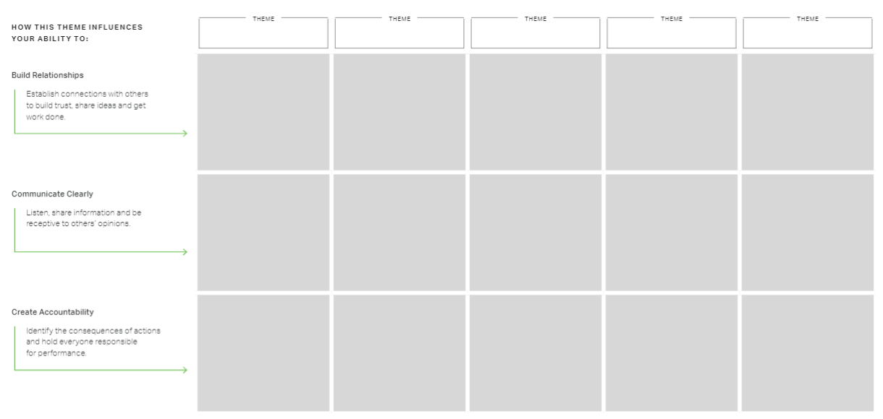
Strengths-Based Leadership

Slide 51
Strengths-Based Leadership
Learner
Intellection
Input
Futuristic
Developer
Ask questions to learn more about others
Seek to understand the future goals and aspirations of others
Pay attention to how individuals prefer to learn and receive support
Ask questions to learn more about others
Consider the multiple ways in which others need to receive communications and how to meet those needs
Collect resources that help me apply communication best practices
Communicate with a developmental purpose in mind to focus messaging
Research accountability tools and techniques to identify best fit for various people
Identify a shared goal from which we align priorities, expectations, and actions
Notes:
https://www.gallup.com/workplace/267017/rethinking-competencies-part-expectations-leaders.aspx

Slide 52
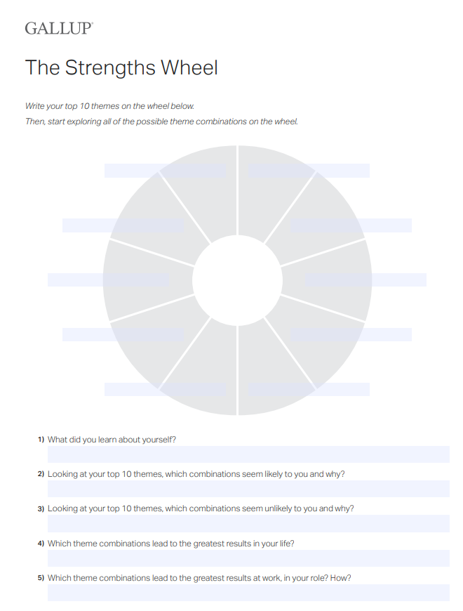
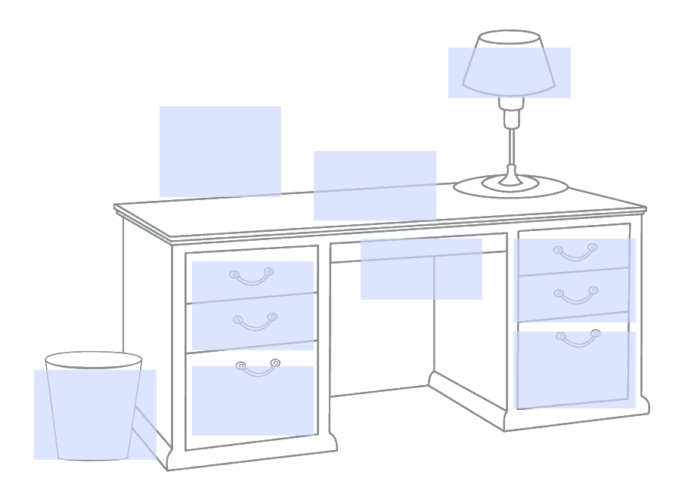
Choose Your Own Adventure

Slide 53
Review & Reflect

Slide 54
Programmatic Throughlines
Deeper understanding of individual strength and contribution
Greater awareness and appreciation for diversity of our teams
Analysis of cultural and contextual influences on use of talents in the workplace
Fostering an inclusive work environment
Skill building: Timely, targeted, specific feedback
Skill building: Communication and boundaries

Slide 55
Personal Insights
People need guidance to understand their strengths with clarity.
Most people carry around harsh internal judgements about themselves (and others).
CliftonStrengths offers common language around which we can have meaningful performance conversations.
Post-pandemic and hybrid teams require intentional team building.

Slide 56
Key Takeaways
What did we learn today?
What still puzzles us?
What lessons do you hope will be carried forward?
Is there anything you’re interested in learning more about?

Slide 57
Resources
Gallup.com/access resources
Books
E-learning, videos
Follow up activities
Theme Thursday Podcast
Coaching.gallup.com
Webcast
Theme Thursday

Slide 58
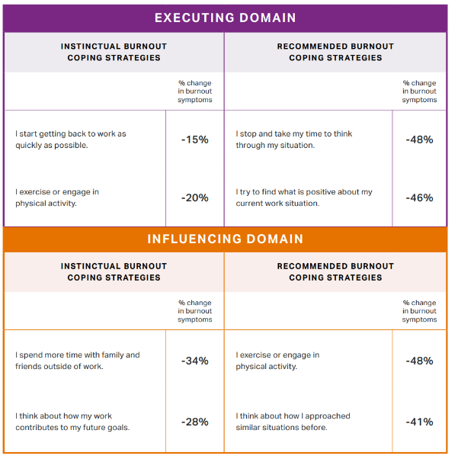
Burnout Guide

Slide 59
Communication Reference Guide

Slide 60
Strengths Insights

Slide 61
Thank you!
Danielle Hook
(517) 884-3798
Dhook@msu.edu

Slide 62
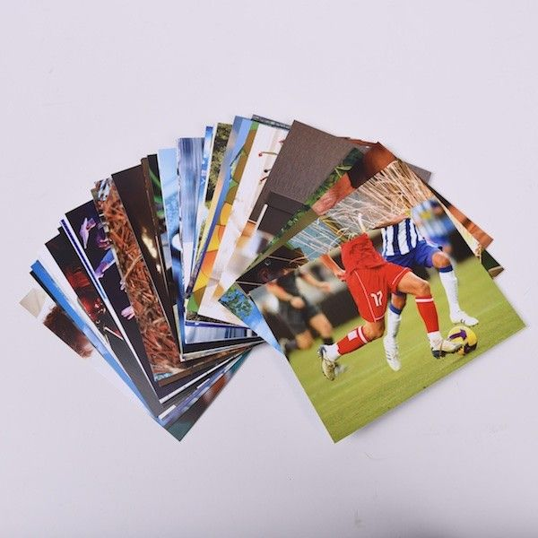
Picture Yourself
Select a photo from the table
Be prepared to share your screen to show your group
Share your selection and the reasoning for that selection with your table

