Slide 1
Information Strategy Template
1
1
2
3
4
What is the issue/problem?
What information is needed?
For what purpose?
From what sources/ resources?
5
6
7
Information for whom?
Provided in what way and in what form?
To engage individuals/groups to facilitate use.
© Nuventive 2023. All rights reserved
Notes:
A foundational component of the program: Introduction to the Information Strategy Template: Learn how to use a template for clarifying the process of moving from the “what” to the “so what.” The framework embedded within the Information Strategy Template will be used throughout the program with further specificity in subsequent modules and will address:

Slide 2
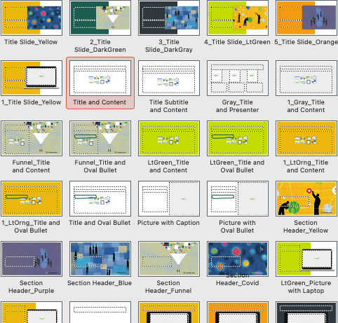
Instructions:
Enter your name and institution on the following slide
We have included blank slides that you can use as appropriate for your needs; other designs can be found by selecting “Layout” from the Home toolbar (see illustration)
Prepare and time your presentation (3-4 minutes and 1-2 slides in addition to the cover slide with your name)
Send your completed slides no later than Sunday December 10 to Amy Morgan amorgan@ncci-cu.org
Presentations will be assembled in alphabetical order by last name; the host will advance the slides for you
Thank you!
Sample layout options

Slide 3
Your name
Your institution

Slide 4
Slide layout 1

Slide 5
Slide layout 2

Slide 6
Two-column slide layout

