Slide 1
Creating Resilient Leaders
SUPPORTING WHOLE-PERSON WELLNESS IN THE WORKPLACE
Jennifer Askey, PhD, PCC
NCCI Power 60
June 2024
Notes:
Short intro – going to start talking about employees, but we are really going to wind up looking at the role of the leader – at any level of the organization

Slide 2
WE ARE NOT OK
44-57% of higher education faculty &
staff are likely to seek work elsewhere.
25%-65% of government employees report
being burned out
Some studies show that only 30% of American
workers fit the criteria for “resilient, ”
leaving 70% “vulernable”
Notes:
stats indicate that the workforce in our industries is NOT ok
Academic Impressions survey indicates that
Gallup & The People Lab @ Harvard both show .
This isn't NEWS, per se. From "don't call me resilient" during the pandemic to "quiet quitting after," private and public sector employers KNOW that there exists in NOrth America a workplace morale problem.
Audience check.
If there is an engagement problem at your organization, what are ppl "blaming" it on?
Values conflict
money, pay, investments
culture of overwork and underpay
bloating of C-level salaries
poor supervisory quality and relationships
recognition duriing pandemic both that work COULD be different and that connections at work DO matter

Slide 3
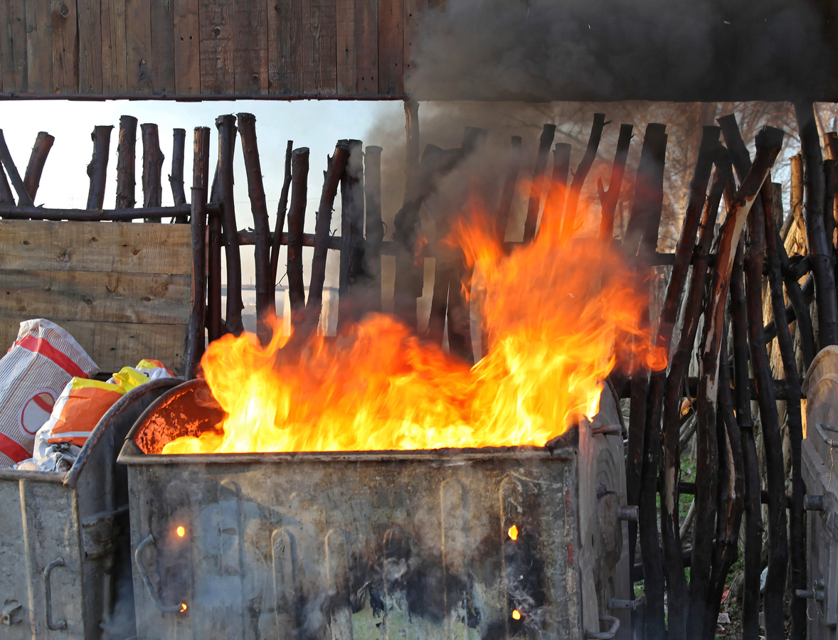
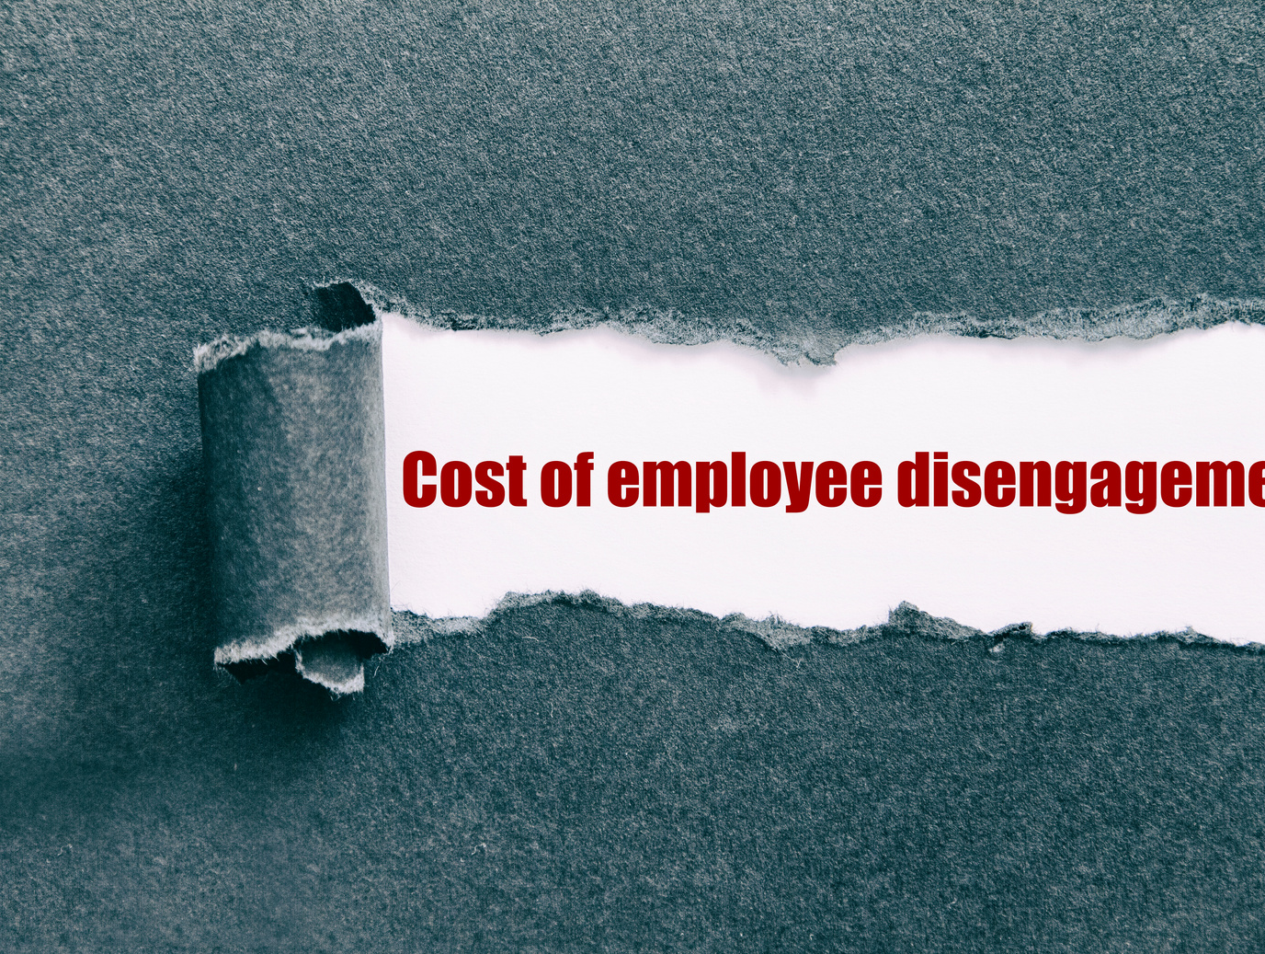
RESULTS
Notes:
What happens when employees are burned out, unresilient, frustrated?
They quit or become disengaged. Turnover. Extra burden on those left behind, bc our sectors don't hire quickly. So the stress and overwork cycle continues
Stressed out employees provide crappy experiences for clients, students, and citizens.
And that dumpster fire there -- that is the reputational damage that high turnover and crappy experience leads to.
Research also shows, and it's no wonder, that a people who are not resilient, not experiencing their work as meaningful, or their contributions as meaningful, and don't have necessary social connections at and to their work are simply less capable of being creative AND less capable of, in turn attaining the resilience and sense of connection that supports creativity!
This vicious cycle is not only demoralizing and wasteful of human talents, it is wasteful o f$$ as well. Gallup indicates that each disengaged employee "costs" its employer 34% of their annual salary, $3,400 for every $10,000 they make.
And don't forget the ripple effect that unhappy, stressed, and disengaged employees have on those around them.

Slide 4
THE SOLUTION
Innovation
Prospection
Social Connection
Mattering
Resilience
Notes:
We know what works.
Research shows it.
Our friends at CultureAmp and WorkTango know it
Common sense likely also knows it – but it is not a program you can implement.
This is the PRISM pyramid from Kellerman and Seligman’s 2023 book Tomorrowmind.
Walk through each of the elements.
Resilience is the foundation up which all other qualities rest.
Then you can have creativity and innovation.

Slide 5
RESILIENCE
The individual/collective capacity to manage the everyday stress of work and remain healthy, rebound and learn from unexpected setbacks, and prepare for future changes proactively.
Working with Resilience
Notes:
Let’s define resilience.
Bounce-back-ability

Slide 6
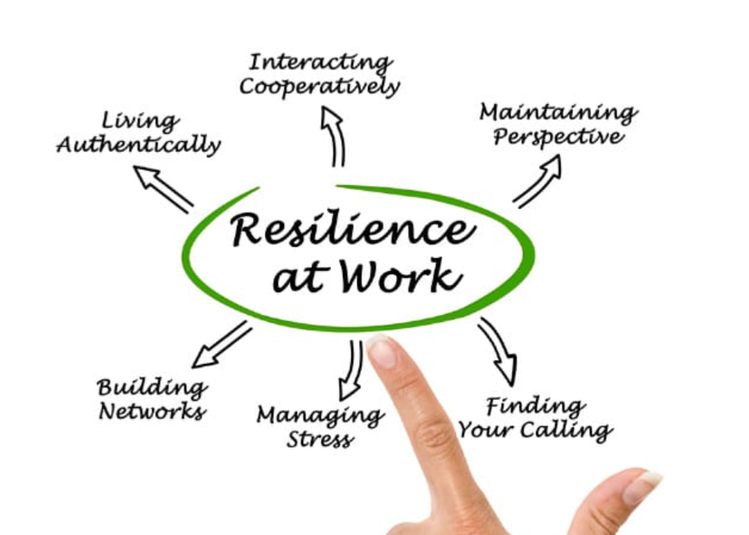
Notes:
This is what organizations get when their employees are resilient!
Audience check – who here feels like their work allows them to authentically live their values? You don’t have to mask who you are at work?
Who believes they have found, at least for this moment in time, their calling!
Excellent!
Those are foundational elements of resilience – and they start on the inside, with self-awareness.
Maintaining perspective – that is returning to optimism & it goes hand in hand with managing stress
Interacting cooperatively – this is psychological safety. Are you in an environment where you can freely offer and receive feedback? Where sharing ideas is safe?
Building networks – you have a network at work and at home and in your profession that provides advice, an ear, practical backup, introductions, mentoring, insider info, etc.
That is a resilient employee.
Interestingly enough, though – a group of resilient employees does not necessarily create a resilient team
The role of the leader – line manager, department head, dean, vice president, chief officer, president . . . Those people “at the top” of the organization and at the front of the room have a greater than individual impact on how well groups of people function. Think of the best leaders you have known and see what you can conjure up about them in these terms?
So, as the saying goes – people don’t leave jobs, they leave managers.
A leader who is not self-aware, who has not spent the time connecting their personal sense of values (or a segment of their personal values) to the mission of their organization – who can’t see both the big picture of the mission amidst the day-to-day work of the unit, is missing part of the foundation for a resilient organiation.
A leader who can’t maintain optimism or manage stress, who can’t give and receive feedback . . . You get it, right? Not only is this leader going to be more difficult to work for than a leader who is self-aware, emotionally agile, and tapped into the mission of the organization – but this perceived “difficulty” actually has an impact on culture.
I’m preaching ot the choir here – but research across industries proves it.

Slide 7
Resilient Leader Components
T1 Robust: Having shared purpose, meaning, and goals. Being adaptable to change and proactive when issue arise.
T2 Resourceful: Harnessing team member strengths and resources against priorities and building a culture of improvement.
T3 Perseverance: Persisting in the face of obstacles and have a solution, rather than a problem, focus.
T4 Self-Care: Promoting and deploying good stress management routines and supporting work-life integration.
T5 Capability: Continually building capacity (as individuals and groups) through accessing networks and supports and advice.
T6 Connected: Contributing to a sense of belonging and support and fostering cultural and psychological safety.
T7 Alignment: Aligning the work to the desired outcomes (including the mission and vision of the organization). Being optimistic, noticing progress and celebrating success.

Slide 8
THE SOLUTION IS PERSONAL
Leadership needs to model resilience and engagement. Management is up to 70% responsible for employee engagement.
Notes:
Yoga during the lunch hour is not the solution.
I approach this work as a coach – meaning that about half of my work is one-on-one with leaders.
What I notice
Stress
Overwork
Lack of self-trust
And interestingly enough, it often boils down to leaders not knowing what leadership success is supposed to look like.
They may have numbers and targets – but do they know what a successful tea feels like?
Leaders, esp in higher ed, the field I’m most familiar with, get zilcho in terms of training – they are promoted based on their subject matter expertise, rather than their EQ or their so-called people skills.
They might not be good mentors
They might approach all problems with a deficit, rather than growth mindset and operate out of fear rather than generosity
They might have run their lab or their private practice with my way or the highway attitudes and don’t know how to create a psychologically safe work environment – bc their own environment may not be safe.
We can only take risks when all of the other elements are present. We can only be creative once our foundational needs for belonging and mattering and meaning are met.
Yoga during lunch isn’t going to do that!
Work intensification is the phrase that Working with Resilience uses.
Tomorrowmind likens the world of work today to whitewater rafting on class 5 rapids.
--> our workplaces need to be human-centred, emotionally agile, psychologically safe workplaces, in order to . . .
--> workplaces are made up of PEOPLE and it is the individual actions of leaders that make the difference here

Slide 9
RESILIENT LEADER BEHAVIOURS
T1 Robust: How do you model & communicate the “why” of your team’s work?
T2 Resourceful: Name a strength of each team member that could be used more and how you could leverage it.
T4 Self-Care: If overload was a stoplight, is your team at green, yellow, or red? Who controls the stoplight?
T6 Connected: Are your staff/faculty proud to be part of your team? How do they demonstrate that pride?
T7 Alignment: How do you lead in a way that builds on what is working well?

Slide 10
ESSENTIAL SKILLS FOR RESILIENT LEADERS
Notes:
The five most important drivers of resilience are:
emotional regulation: the ability to effectively manage our emotions without being controlled by them;
cognitive agility: the ability to alternate between opportunistic scoping and focused effort;
optimism: the tendency to imagine positive outcomes;
self-efficacy: our belief in our ability to accomplish our goals; and
self-compassion: the ability to extend compassion to ourselves.

Slide 11
MASTER THE PAUSE!
Notes:
Those five qualities on the last slide – what do they have in common?
All of us, but esp leaders, need to be able to interrupt our default patterns – to master the pause -- and our knee jerk emotional responses in order to choose intentions – to give ourselves the opportunity to return to what we have thoughtfully prepared and intended.
Stop
Challenge
Choose
Now – this can be mindfulness and a meditation practice. This is my personal fave. But that mmindfulness practice – even in the lunchroom sponsored by HR – I sjust the practice session for real life.
Our leaders and our organizations need systems and structures that don’t in themselves promise resiliency, but that create the spaces and the habits and the expectations that, as leaders, we are not emotionally in the mosh pit of the work, but also have the capacity to climb up onto the balcony and observe – ourselves and others – and choose a path forward that is values aligned and people first.
Thanks you.

Slide 12
Q & A

Slide 13
Thank you!
Please join me for a series of roundtables on Creating Campus Culture, starting May 28
Jennifer@jenniferaskey.com

